Slide 1
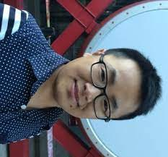
ACL-2022 Tutorial: Part A: Simple Uses of Deep Nets
Ken
Valia
Gary
Ernie
Yanjun
Zeyu
Ken Church, Baidu, USA
Valia Kordoni, Humboldt-Universitaet zu Berlin, Germany
Gary Marcus, Robust.AI
Ernest Davis, NYU
Yanjun MA, Baidu, China
Zeyu Chen, Baidu, China

Slide 2
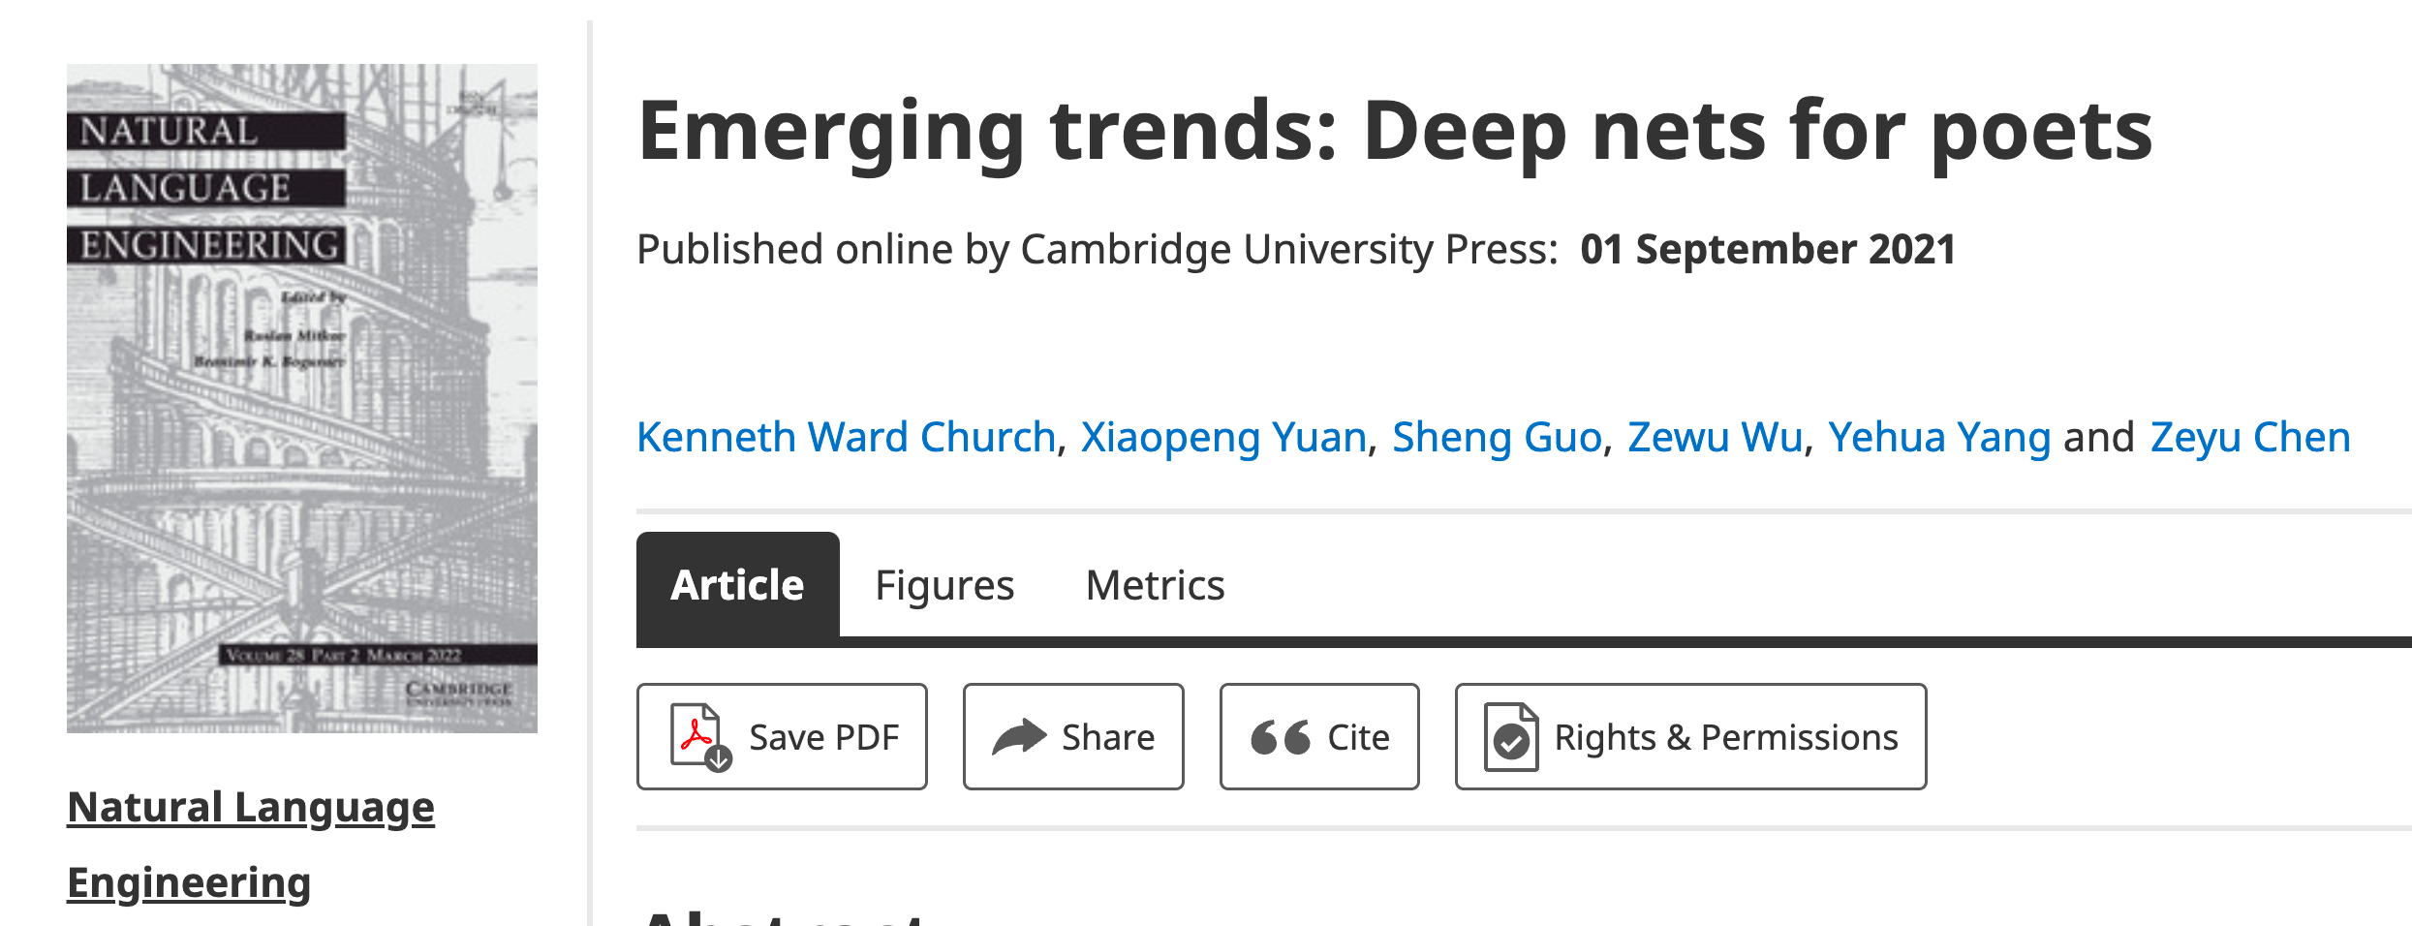
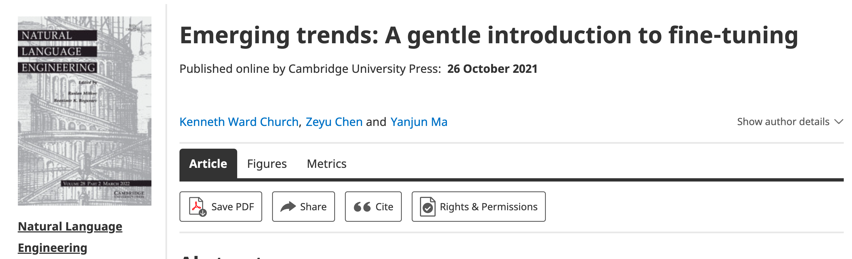
Part A: Simple Uses of Deep Nets
Ken
Schedule
Part A: Glass is Half Full
Simple/Popular Methods are Powerful
Yanjun
Zeyu
Overview (15 min)
Part A: (60 min)
Glass is half full
Break/Q&A (10 min)
Part B: (60 min)
Glass is half empty
There is always more work to do
Conclusions (15 min)
Break/Q&A (10 min)
Gary
Valia
Ernie

Slide 3
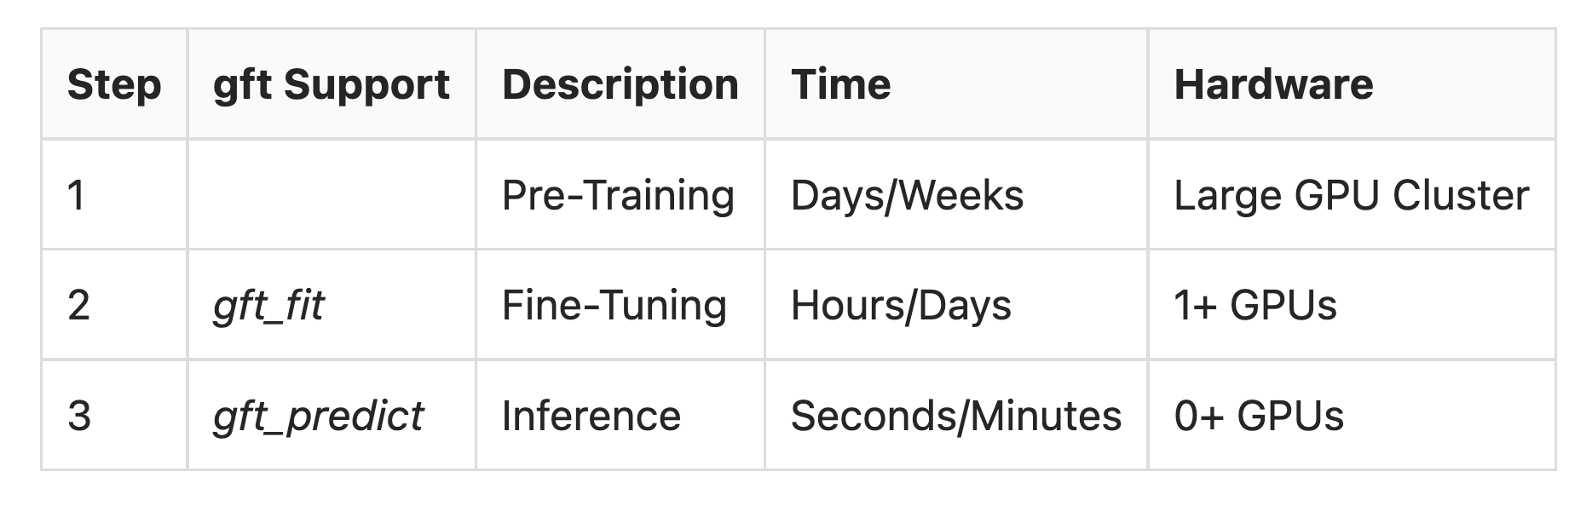
Standard 3-Step Recipe
$$$$
$

Slide 4
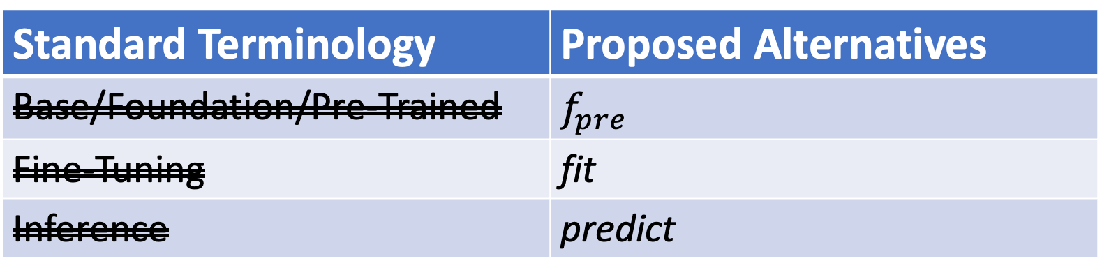
Terminology
Standard Terminology | Proposed Alternatives
Base/Foundation/Pre-Trained | $$f_{pre}$$
Fine-Tuning | fit
Inference | predict
Emphasize this
Emphasize this
De-emphasize this

Slide 5
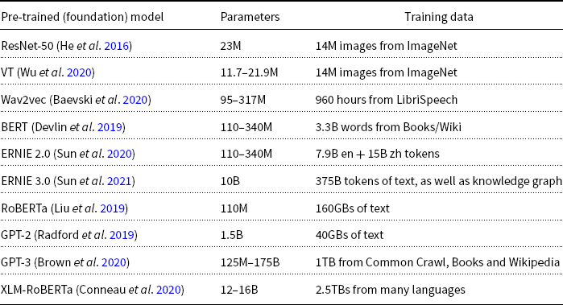
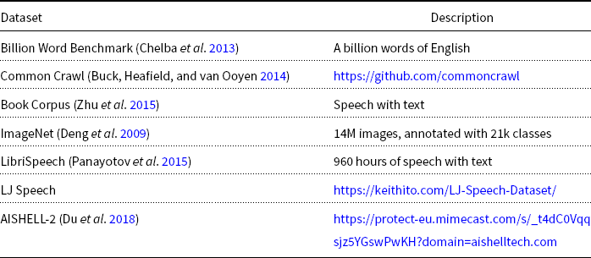
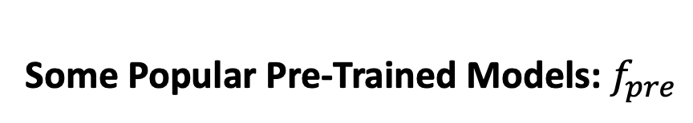

Base/Foundation/Pre-Trained Models Recommendation: Download $f_{pre}$from Hubs
Some Popular Pre-Trained Models: $f_{pre}$
Some Popular Datasets for Pre-Training
DDI → Don’t Do It (yourself)

Slide 6
Terminology
Standard Terminology | Proposed Alternatives
Base/Foundation/Pre-Trained | $$f_{pre}$$
Fine-Tuning | fit
Inference | predict
Emphasize this
Emphasize this
De-emphasize this
We will discuss why we want to change the terminology later

Slide 7
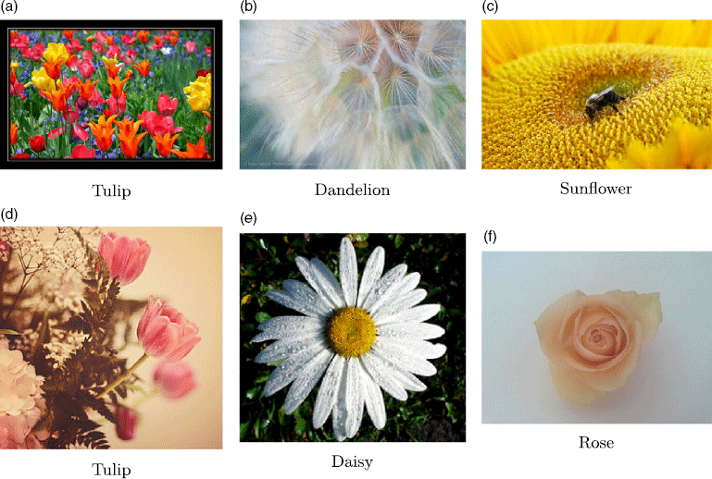
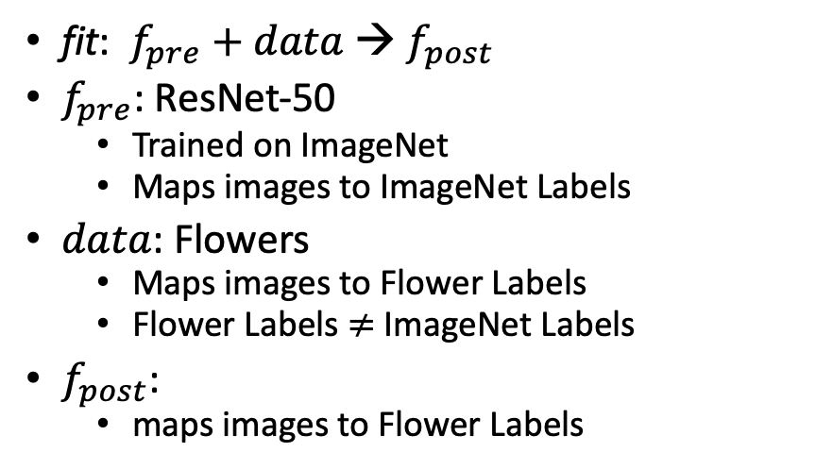

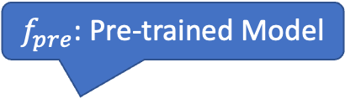
What is fine-tuning fit?
Flowers
$$data$$
fit: $f_{pre}$ $+ data$→ $f_{post}$
$f_{pre}$: ResNet-50
Trained on ImageNet
Maps images to ImageNet Labels
$data$: Flowers
Maps images to Flower Labels
Flower Labels $≠$ ImageNet Labels
$f_{post}$:
maps images to Flower Labels
$f_{pre}$: Pre-trained Model

Slide 8
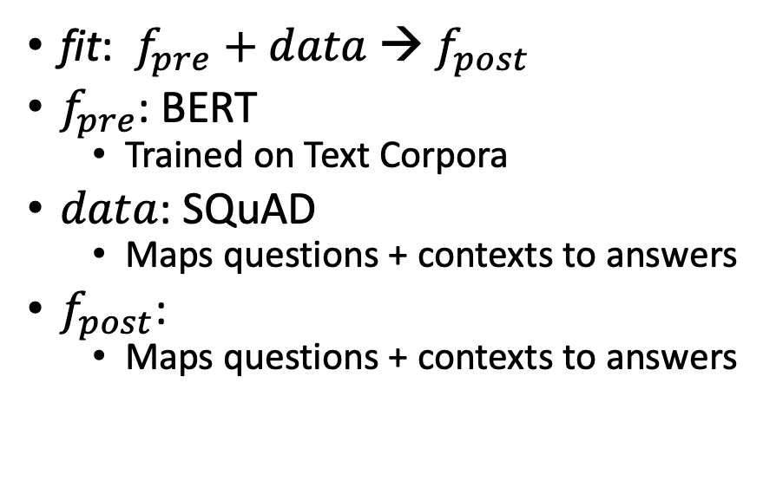
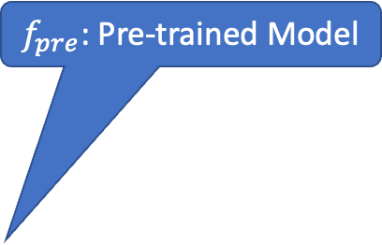
What is fine-tuning fit?
Classify Spans:
Answer is a substring of context
Task: Question-Answering (QA)
SQuAD
fit: $f_{pre}$ $+ data$→ $f_{post}$
$f_{pre}$: BERT
Trained on Text Corpora
$data$: SQuAD
Maps questions + contexts to answers
$f_{post}$:
Maps questions + contexts to answers
Question:
What does AFC stand for?
Context:
The American Football Conference (AFC) champion Denver Broncos defeated the National Football Conference (NFC) champion Carolina Panthers 24–10 to earn their third Super Bowl title.
Answer:
American Football Conference
Text with no markup
$f_{pre}$: Pre-trained Model

Slide 9
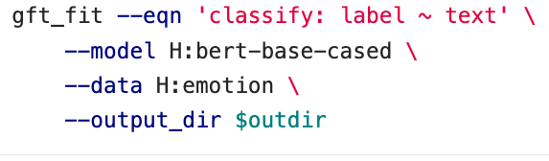
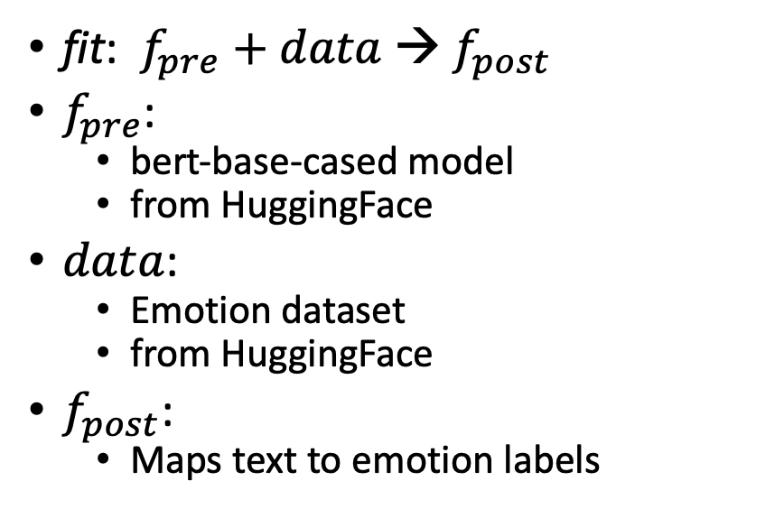
What is fine-tuning fit?
fit: $f_{pre}$ $+ data$→ $f_{post}$
$f_{pre}$:
bert-base-cased model
from HuggingFace
$data$:
Emotion dataset
from HuggingFace
$f_{post}$:
Maps text to emotion labels
gft Program

Slide 10
What is fine-tuning fit?
gft Programs
H → HuggingFace
fit: $f_{pre}$ $+ data$→ $f_{post}$
$f_{pre}$:
bert-base-cased model
from HuggingFace
$data$:
Emotion dataset
from HuggingFace
$f_{post}$:
Maps text to emotion labels
gft_fit --model H:bert-base-cased \
--data H:emotion \
--output_dir $1 \
--eqn 'classify: label ~ text'
P → PaddleNLP
gft_fit --model P:ernie-tiny \
--data P:chnsenticorp \
--output_dir $1 \
--eqn 'classify: label ~ text'

Slide 11
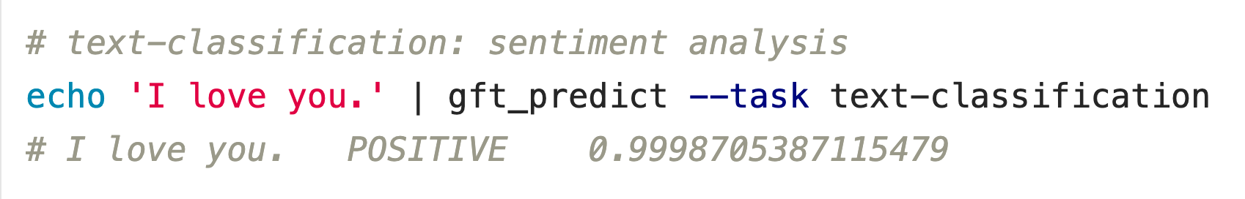

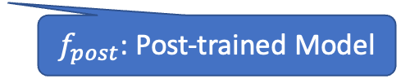
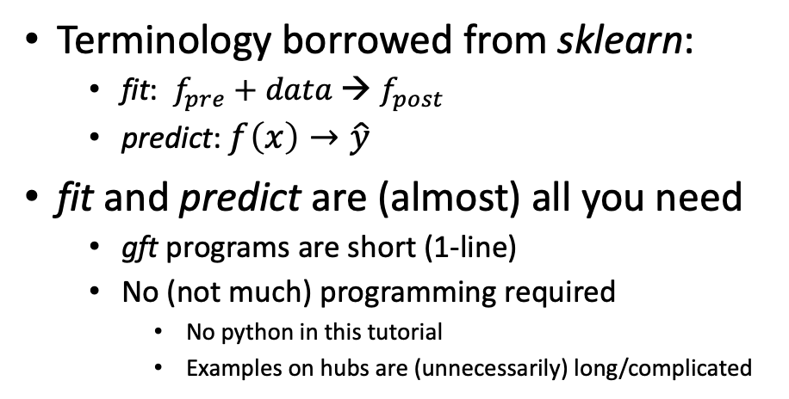
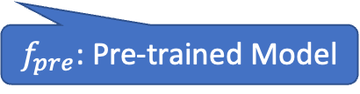

gft (general fine-tuning): A Little Language for Deep Nets (Unix Philosophy: Less is More)
Standard 3-Step Recipe
Examples of 1-line GFT Programs
Step 2: gft_fit
Data
$f_{pre}$: Pre-trained Model
Terminology borrowed from sklearn:
fit: $f_{pre}$ $+ data$→ $f_{post}$
predict: $f\left(x\right)→\hat{y}$
fit and predict are (almost) all you need
gft programs are short (1-line)
No (not much) programming required
No python in this tutorial
Examples on hubs are (unnecessarily) long/complicated
$f_{post}$: Post-trained Model
Step 3: gft_predict
$$x$$
$$\hat{y}$$
Score

Slide 12
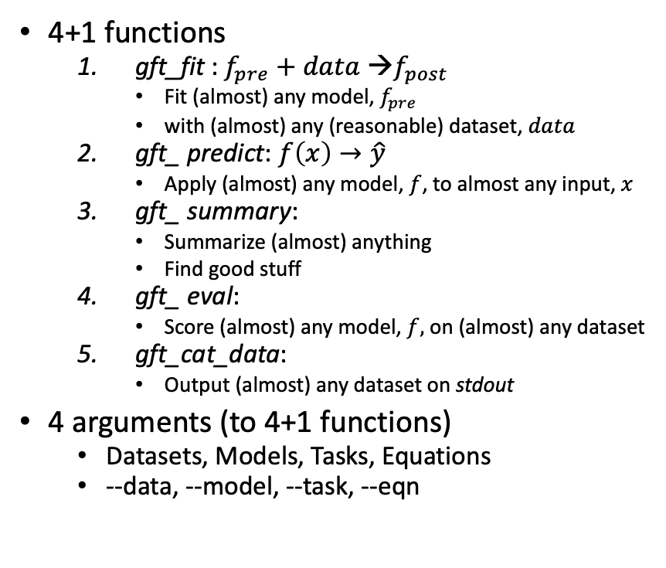
Goals (Work in Progress)
4+1 functions
gft_fit : $f_{pre}$ $+ data$→$f_{post}$
Fit (almost) any model, $f_{pre}$
with (almost) any (reasonable) dataset, $data$
gft_ predict: $f\left(x\right)→\hat{y}$
Apply (almost) any model, $f$, to almost any input, $x$
gft_ summary:
Summarize (almost) anything
Find good stuff
gft_ eval:
Score (almost) any model, $f,$ on (almost) any dataset
gft_cat_data:
Output (almost) any dataset on stdout
4 arguments (to 4+1 functions)
Datasets, Models, Tasks, Equations
--data, --model, --task, --eqn
Ease of Use
Simplicity
Consistent Terminology
Small set of functions/args cover most cases
Generality: Avoid special cases
Dataset/Model/Task/Equations
Interoperability
(Almost) everything works
on (almost) any (reasonable) dataset/model/task/equation
with (almost) no changes
Supplier Agnostic:
Everything works everywhere
(as much as possible): H/P/C
H:glue,cola → Use cola subset of glue from HuggingFace
P:glue,cola → Same as above, but from PaddleNLP
C:$gft/datasets/syn_ant/tag-$pos-pairs → local filesystem

Slide 13
Portability: Mix and Match Across Suppliers
All HuggingFace (H)
Model from P; Data from H
gft_fit --pretrained H:bert-base-cased \
--data H:glue,qnli \
--metric H:glue,qnli \
--output_dir $1 \
--eqn 'classify: label ~ question + sentence' \
--num_train_epochs 3
gft_fit --pretrained P:bert-base-cased \
--data H:glue,qnli \
--metric H:glue,qnli \
--output_dir $1 \
--eqn 'classify: label ~ question + sentence' \
--num_train_epochs 3
gft_fit --pretrained P:bert-base-cased \
--data P:glue,qnli \
--metric H:glue,qnli \
--output_dir $1 \
--eqn 'classify: labels ~ sentence1 + sentence2' \
--num_train_epochs 3

Slide 14
Reality Check
gft takes dependencies on many python packages
Lots of moving targets
Currently not possible to support everything
Under a single virtual environment
Best attempt to support as much functionality as possible
pip install –r $gft/requirements/requirements.txt
Special cases
pip install –r $gft/requirements/requirements_with_adapters.txt
pip install –r $gft/requirements/requirements_without_adapters.txt
pip install –r $gft/requirements/requirements_for_paddlespeech.txt

Slide 15
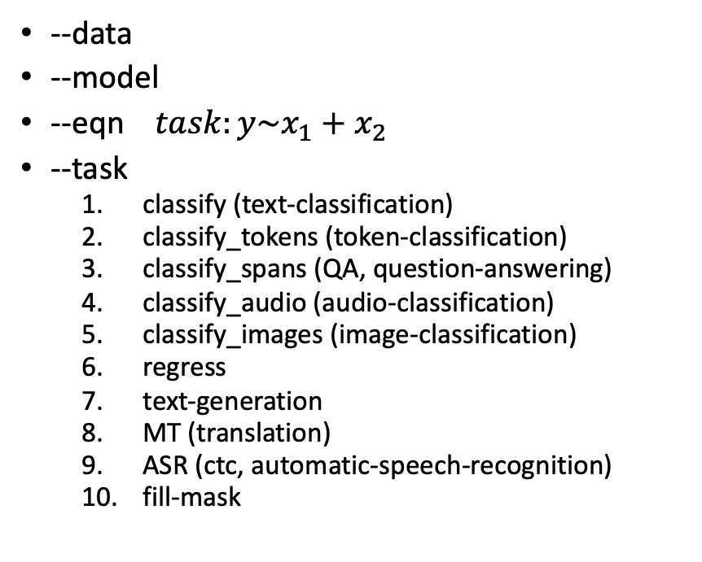
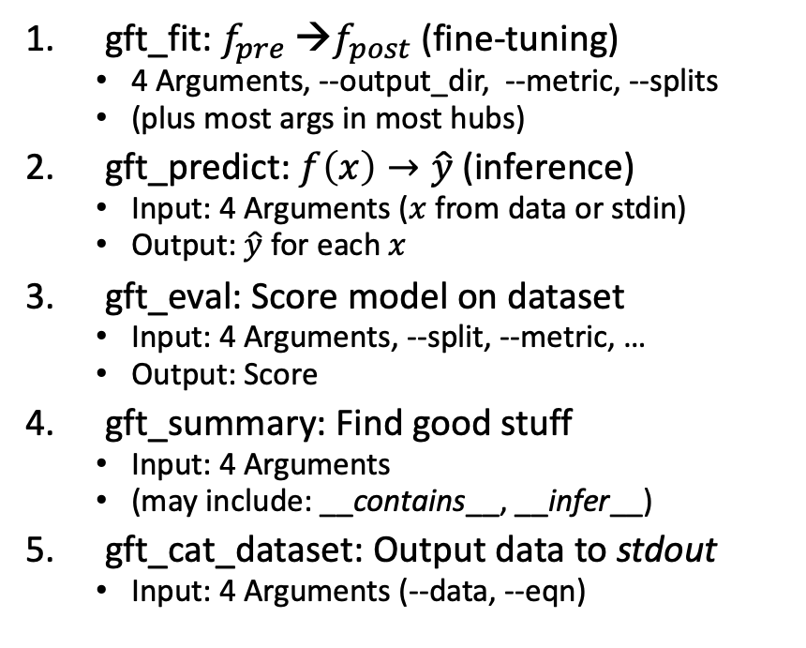
gft Cheat Sheet
4+1 Functions
4 Arguments
gft_fit: $f_{pre}$ →$f_{post}$(fine-tuning)
4 Arguments, --output_dir, --metric, --splits
(plus most args in most hubs)
gft_predict: $f\left(x\right)→\hat{y}$ (inference)
Input: 4 Arguments ($x$ from data or stdin)
Output: $\hat{y}$ for each $x$
gft_eval: Score model on dataset
Input: 4 Arguments, --split, --metric, …
Output: Score
gft_summary: Find good stuff
Input: 4 Arguments
(may include: __contains__, __infer__)
gft_cat_dataset: Output data to stdout
Input: 4 Arguments (--data, --eqn)
--data
--model
--eqn $task:y\sim x_{1}+x_{2}$
--task
classify (text-classification)
classify_tokens (token-classification)
classify_spans (QA, question-answering)
classify_audio (audio-classification)
classify_images (image-classification)
regress
text-generation
MT (translation)
ASR (ctc, automatic-speech-recognition)
fill-mask

Slide 16
Seven Simple Examples
Summary
Summary with patterns (__contains__)
Predict: Sentiment Analysis & Text Classification
More tasks: token_classification, fill-mask
Input from datasets (as opposed to stdin)
gft_predict → gft_eval
gft_fit (aka fine-tuning)

Slide 17
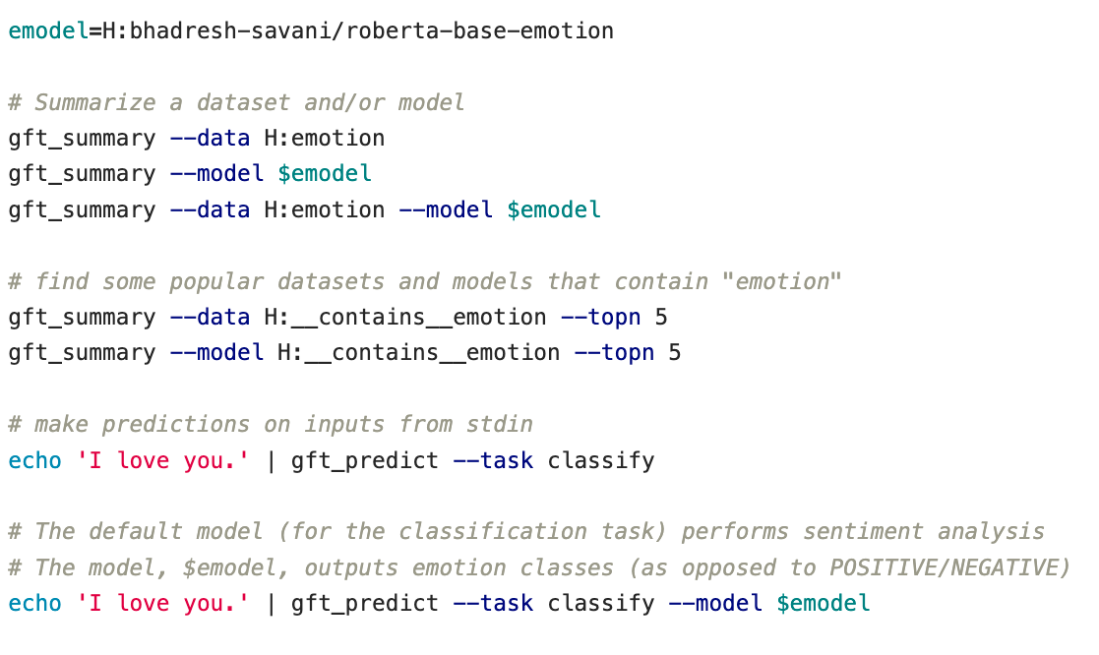
Seven Simple Examples: 1 of 7 Summarize (almost) anything
Emotion Classes
Summarize both data and model

Slide 18
Seven Simple Examples: 2 of 7 Summary with patterns (__contains__)
Find datasets on HuggingFace that contain “emotion”
Find models on HuggingFace that contain “emotion”

Slide 19
Seven Simple Examples: 3 of 7 Predict: Sentiment Analysis & Text Classification
Default model → Sentiment Analysis
Emotion Classes

Slide 20
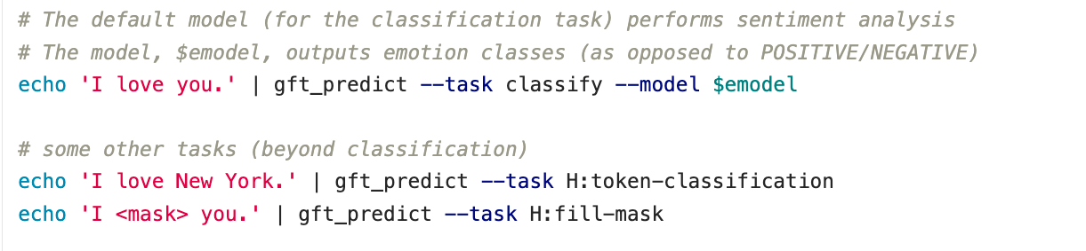
Seven Simple Examples: 4 of 7 More tasks: token_classification, fill-mask
NER: Named Entity Recognition
Cloze (1953)
https://en.wikipedia.org/wiki/Cloze_test

Slide 21
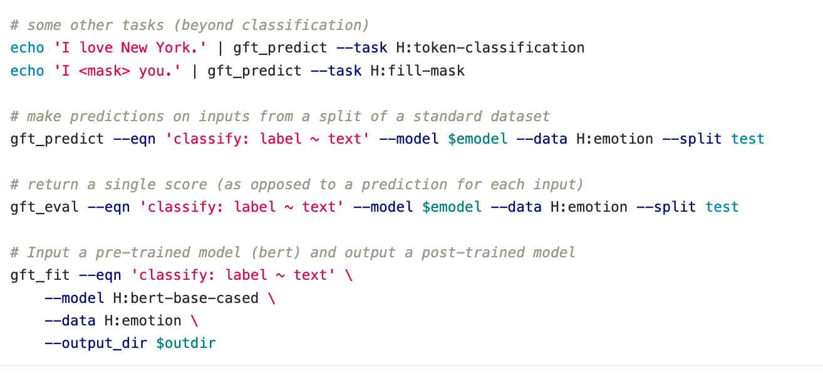
Seven Simple Examples: 5 of 7 Input from datasets (as opposed to stdin)
Specify split
Equation specifies task & columns
Read Input from dataset
(as opposed to stdin)

Slide 22
gft_cat_data --data H:emotion --eqn 'classify:label ~ text' 2>/dev/null | head
Equation specifies task & columns
text | label
im feeling rather rotten so im not very ambitious right now | 0
im updating my blog because i feel shitty | 0
i never make her separate from me because i don t ever want her to feel like i m ashamed with her | 0
i left with my bouquet of red and yellow tulips under my arm feeling slightly more optimistic than when i arrived | 1
i was feeling a little vain when i did this one | 0
i cant walk into a shop anywhere where i do not feel uncomfortable | 4
i felt anger when at the end of a telephone call | 3
i explain why i clung to a relationship with a boy who was in many ways immature and uncommitted despite the excitement i should have been feeling for getting accepted into the masters program at the university of virginia | 1
i like to have the same breathless feeling as a reader eager to see what will happen next | 1
i jest i feel grumpy tired and pre menstrual which i probably am but then again its only been a week and im about as fit as a walrus on vacation for the summer | 3

Slide 23
Seven Simple Examples: 6 of 7 gft_predict → gft_eval
Eval returns a single score for the dataset split
(as opposed to a prediction for each example in dataset split)

Slide 24

A Few Simple Examples: 7 of 7 gft_fit (aka fine-tuning)
Fit returns a post-trained model: $f_{post}$

Slide 25
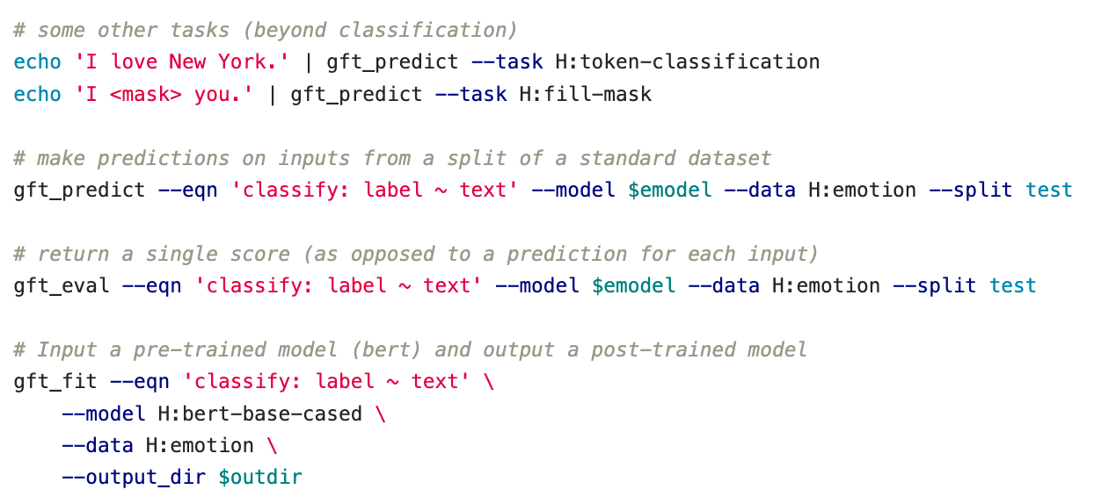
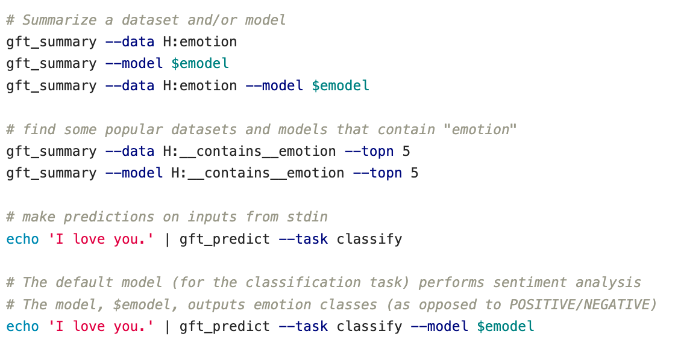
Recap of Seven Simple Examples
4
5
6
1
7
Summary
Summary with patterns (__contains__)
Sentiment Analysis & Text Classification
More tasks: token_classification, fill-mask
Input from datasets (as opposed to stdin)
gft_predict → gft_eval
gft_fit (aka fine-tuning)
2
3
3

Slide 26
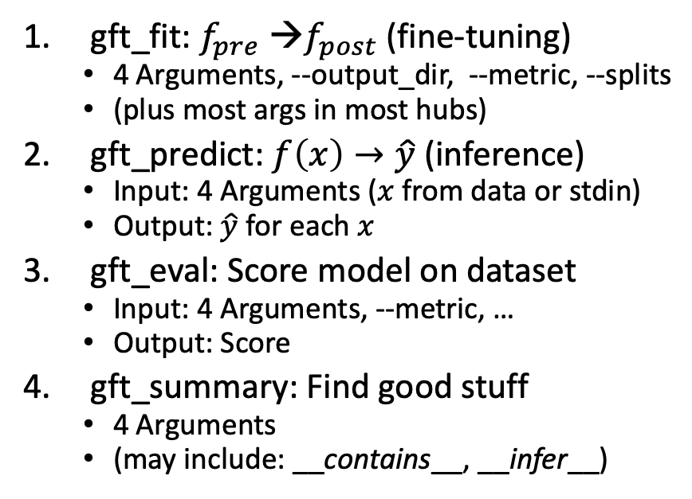
Hundreds of Examples: Robustness / Regression Testing
Subdirectories under $gft/examples
4 Functions
fit_examples
predict_examples
eval_examples
summary_examples
Look for *.sh files under these directories
find $gft/examples –name ”*.sh”
4 arguments:
--data, --model, --eqn, --task
gft_fit: $f_{pre}$ →$f_{post}$(fine-tuning)
4 Arguments, --output_dir, --metric, --splits
(plus most args in most hubs)
gft_predict: $f\left(x\right)→\hat{y}$ (inference)
Input: 4 Arguments ($x$ from data or stdin)
Output: $\hat{y}$ for each $x$
gft_eval: Score model on dataset
Input: 4 Arguments, --metric, …
Output: Score
gft_summary: Find good stuff
4 Arguments
(may include: __contains__, __infer__)

Slide 27
Input: I love you Output: Depends on Model (among other things)
Task: classify
Models:
Sentiment
Expected output label: positive
Fake News:
Expected output label: not fake (real)
Spam/Ham:
Expected output label: not spam (ham)
for model in …
do
echo I love you |
gft_predict \
--task classify \
--model $model
done

Slide 28
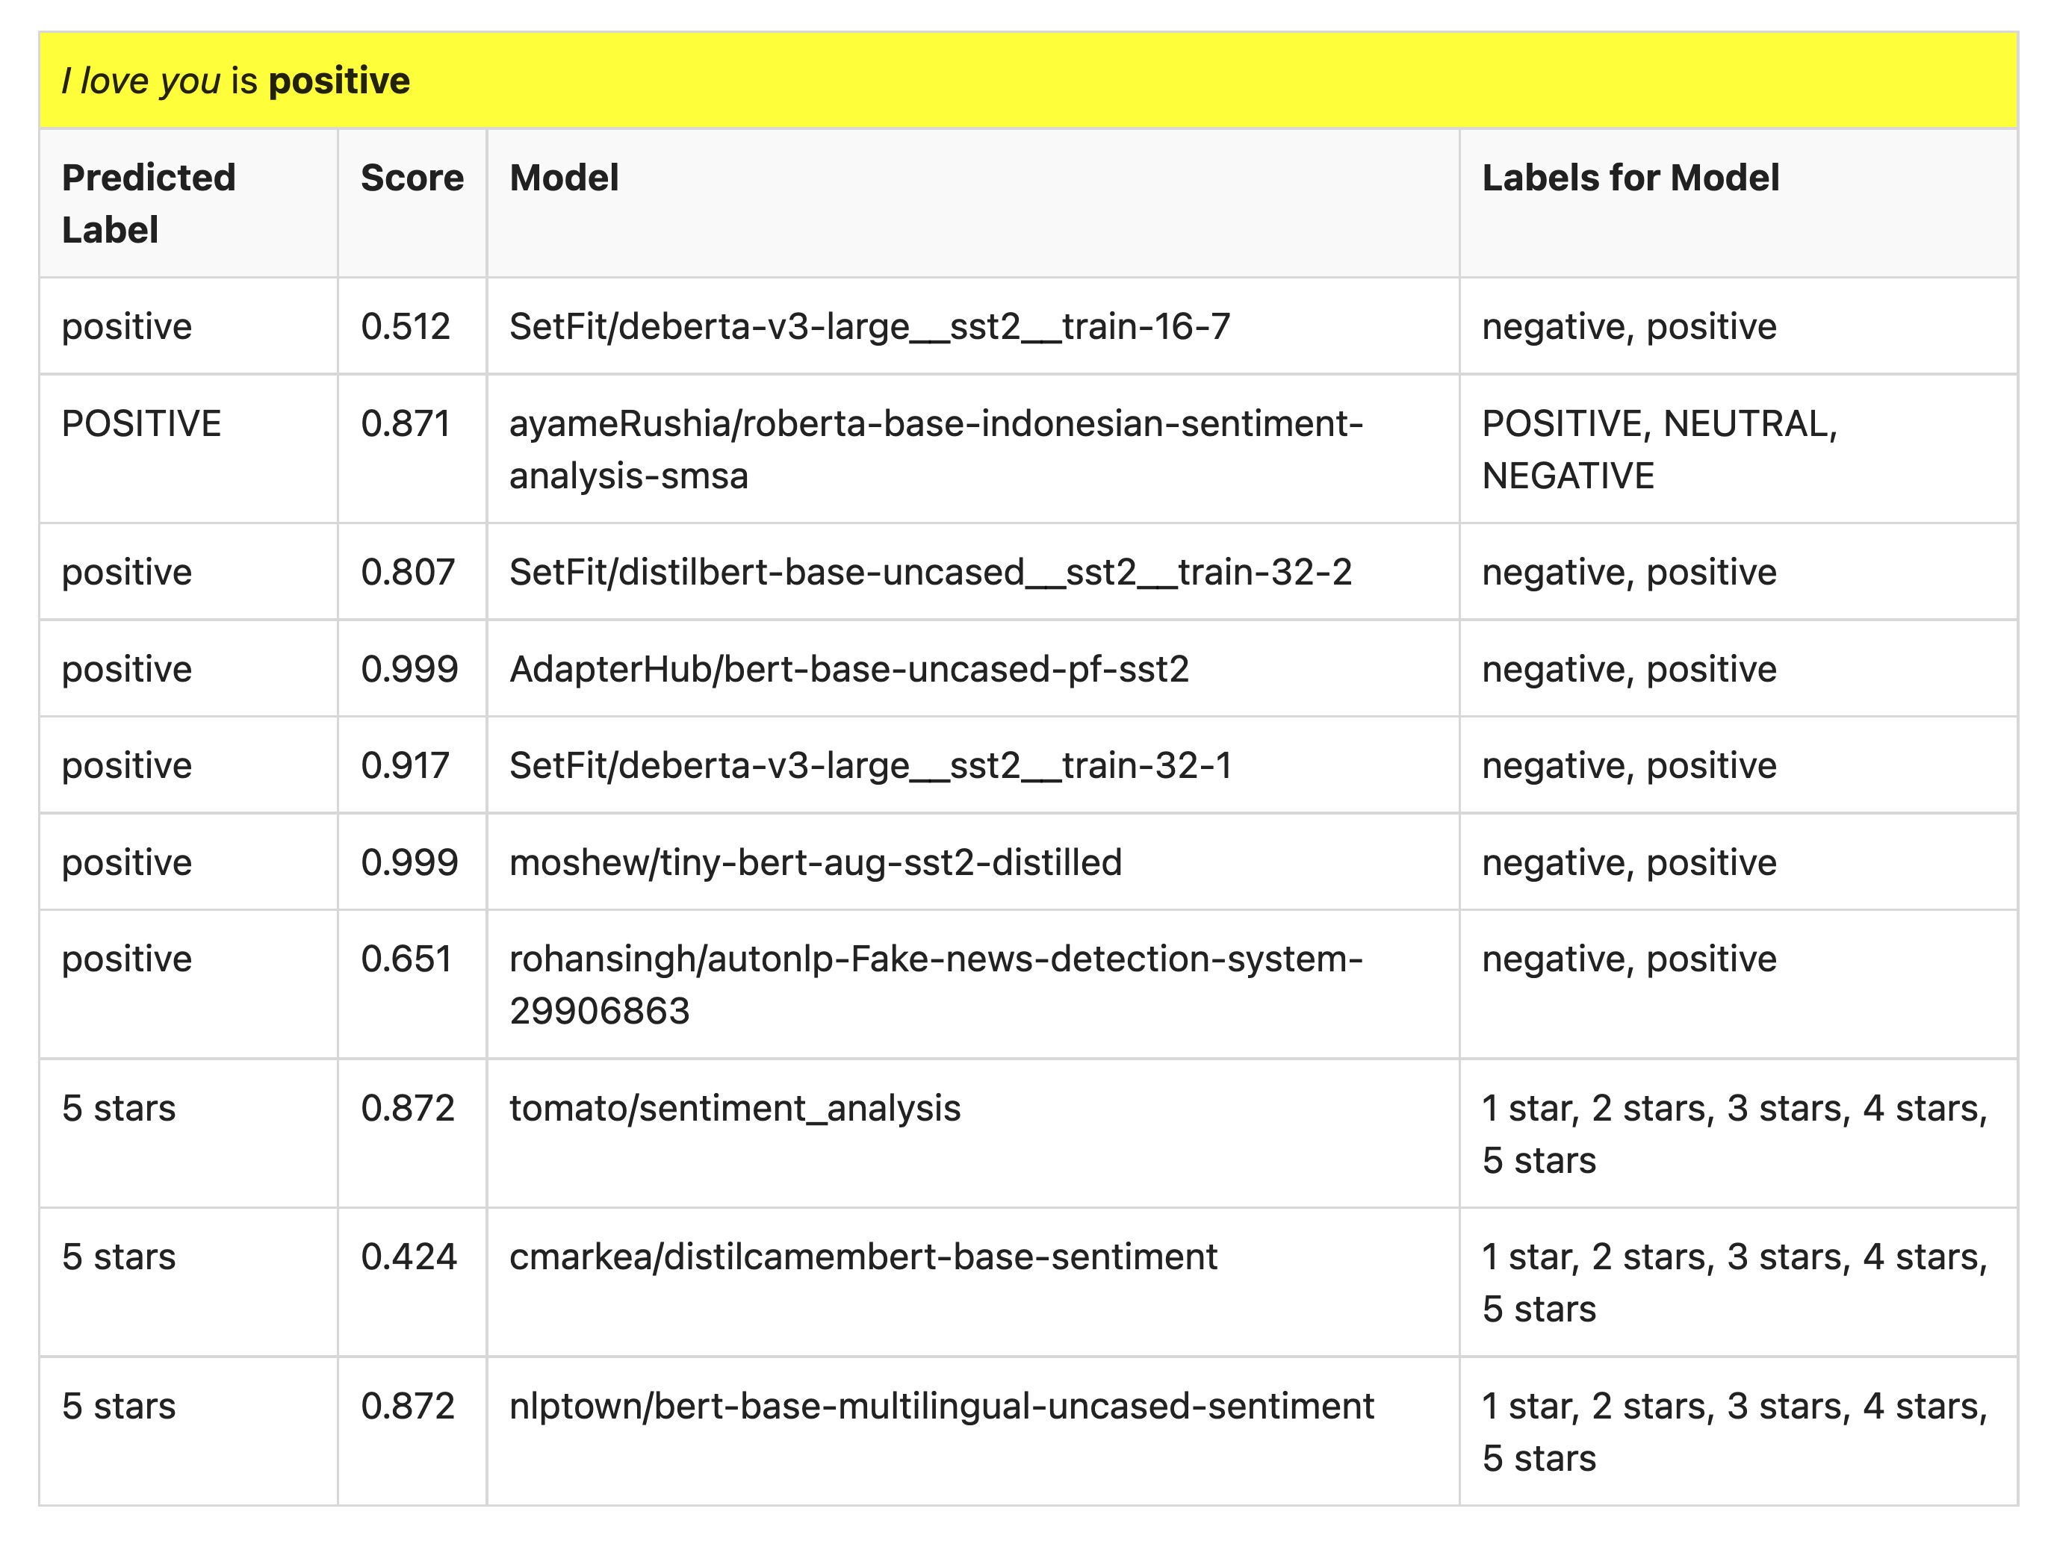
Many of these models produce reasonable results
Scores could be more confident

Slide 29
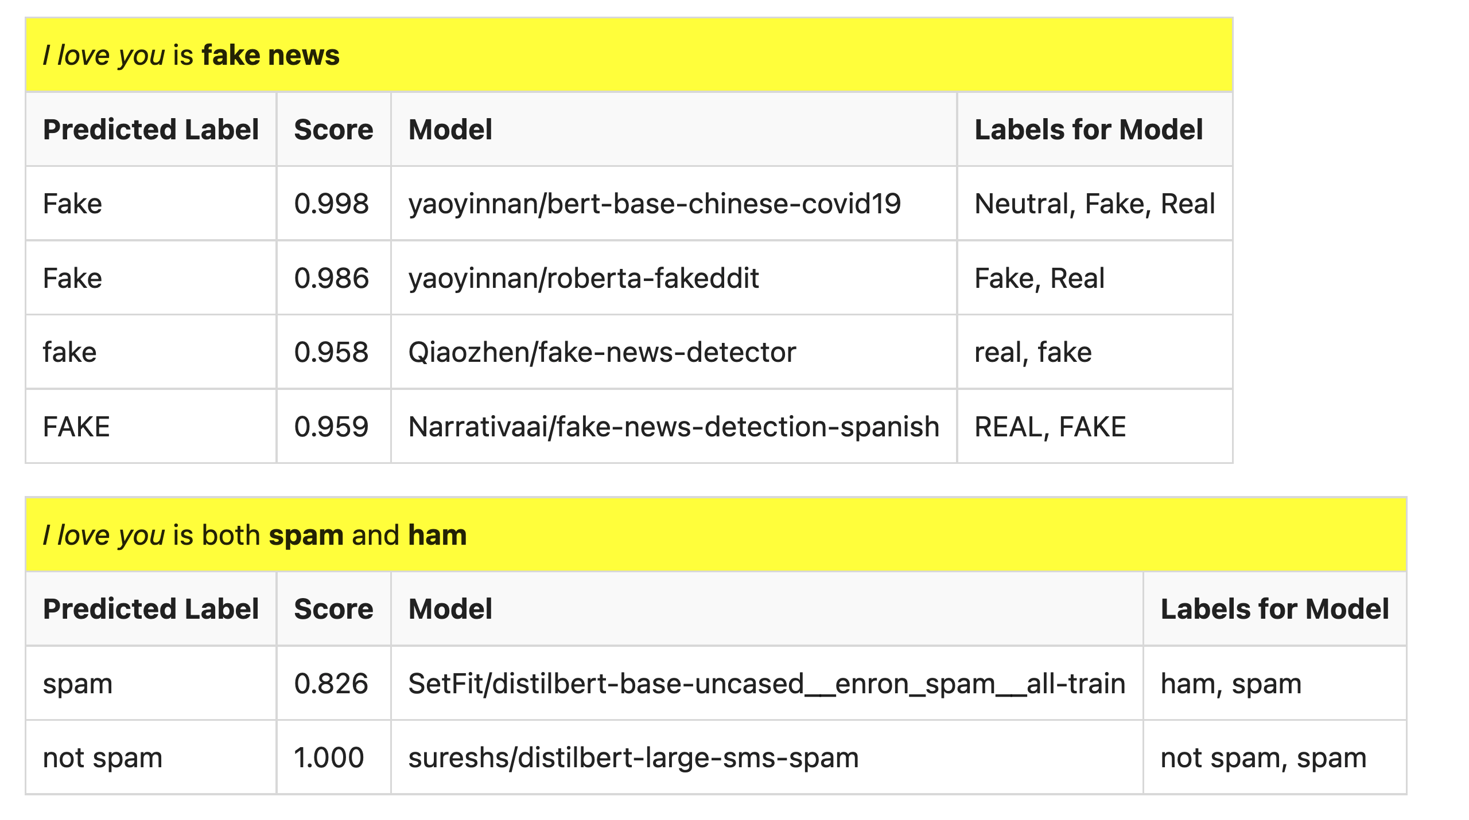
But…

Slide 30
fit and predict can do much (but not everything)
A: Ken Church
B: Valia Kordoni
B: Gary Marcus
B: Ernie Davis
A: Yanjun Ma
A: Zeyu Chen
Part A: Glass is half full
Part B: Glass is half empty
gft is (almost) all you need
to cover much of
the recent excitement in deep nets
Amazing how much can be done
with so little
But also demystifies deep nets
No one would suggest fit & predict are AI
A: Ken Church, Yanjun Ma & Zeyu Chen
Many issues go beyond fit & predict
Traditional views in AI
Causality, Truth, Time, Space
B: Gary Marcus & Ernie Davis
Traditional views in Linguistics
B: Valia Kordoni

Slide 31
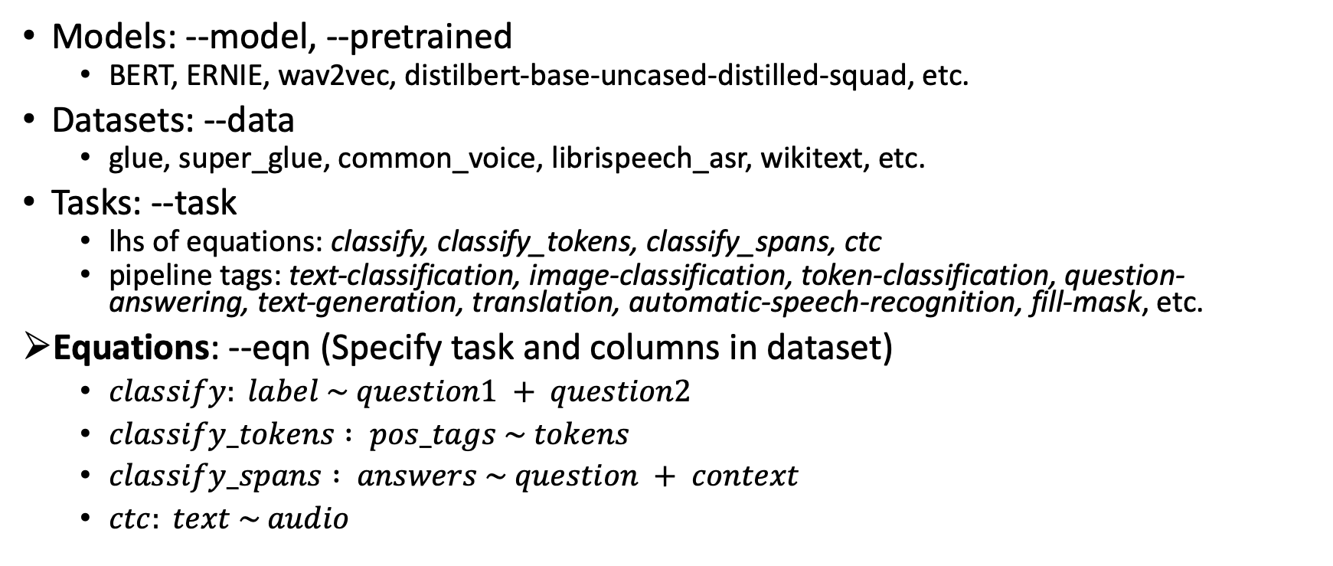
Arguments to fit, predict, summary, eval
Models: --model, --pretrained
BERT, ERNIE, wav2vec, distilbert-base-uncased-distilled-squad, etc.
Datasets: --data
glue, super_glue, common_voice, librispeech_asr, wikitext, etc.
Tasks: --task
lhs of equations: classify, classify_tokens, classify_spans, ctc
pipeline tags: text-classification, image-classification, token-classification, question-answering, text-generation, translation, automatic-speech-recognition, fill-mask, etc.
Equations: --eqn (Specify task and columns in dataset)
$classify: label \sim question1 + question2$
$classify_tokens : pos_tags \sim tokens$
$classify_spans : answers \sim question + context$
$ctc: text \sim audio$

Slide 32
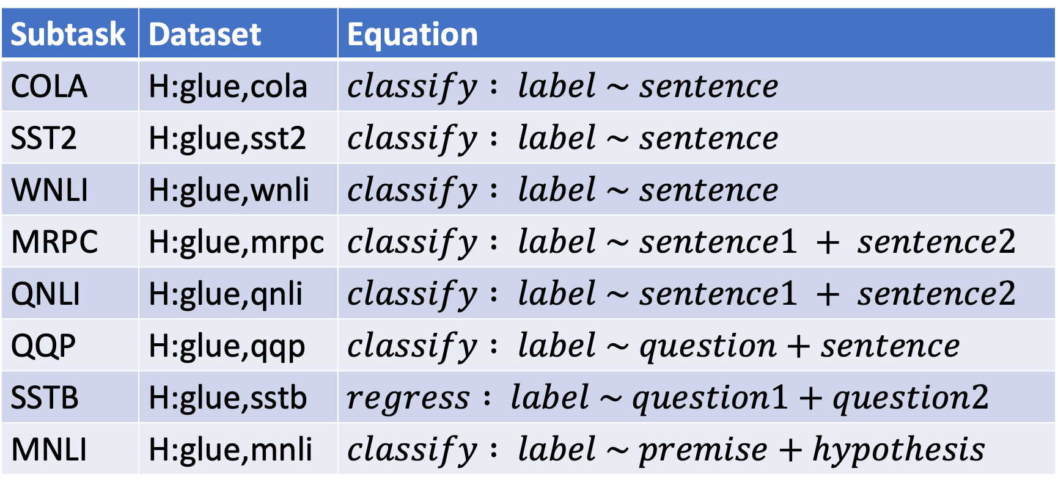
Simple Equations Cover Many Cases of Interest GLUE: A Popular Benchmark
Subtask | Dataset | Equation
COLA | H:glue,cola | $$classify : label \sim sentence$$
SST2 | H:glue,sst2 | $$classify : label \sim sentence$$
WNLI | H:glue,wnli | $$classify : label \sim sentence$$
MRPC | H:glue,mrpc | $$classify : label \sim sentence1 + sentence2$$
QNLI | H:glue,qnli | $$classify : label \sim sentence1 + sentence2$$
QQP | H:glue,qqp | $$classify : label \sim question+sentence$$
SSTB | H:glue,sstb | $$regress : label \sim question1+question2$$
MNLI | H:glue,mnli | $$classify : label \sim premise+hypothesis$$
Select Column in Dataset

Slide 33
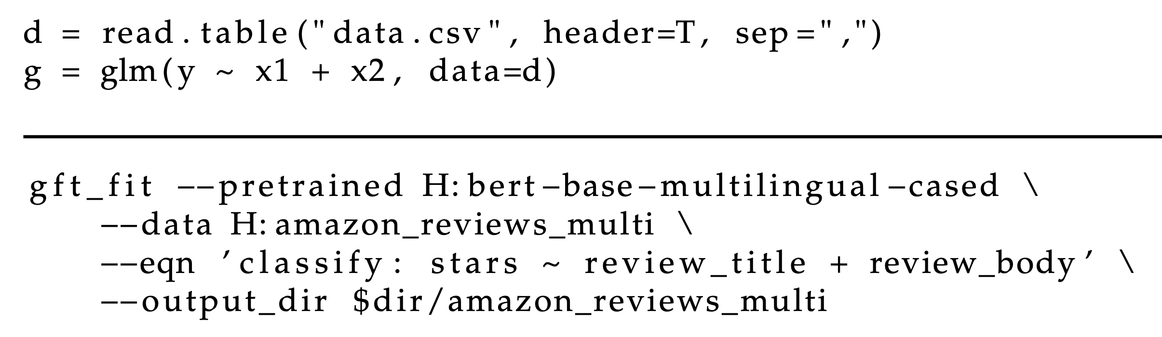
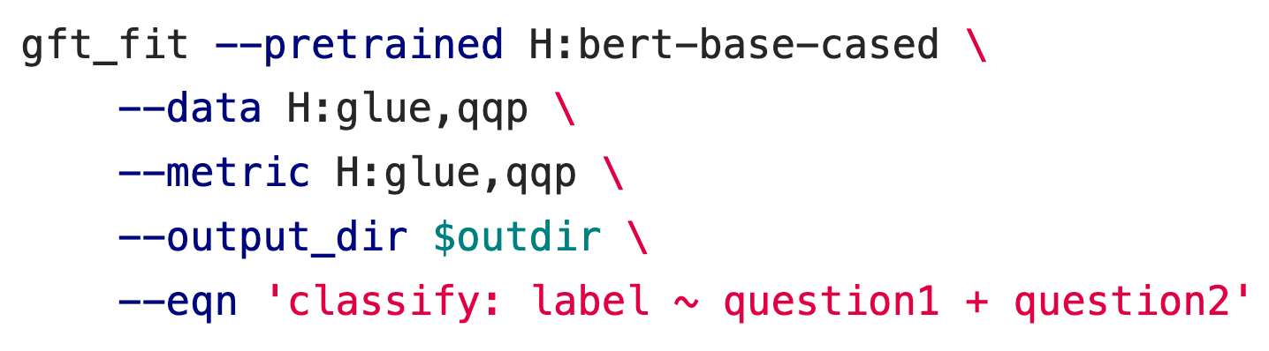
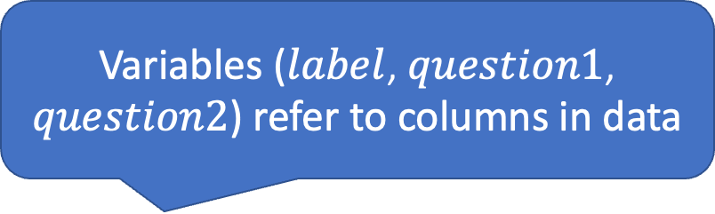
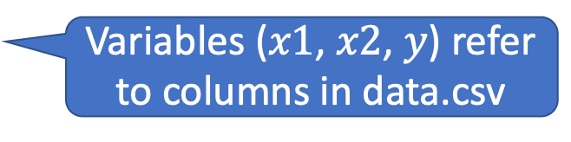
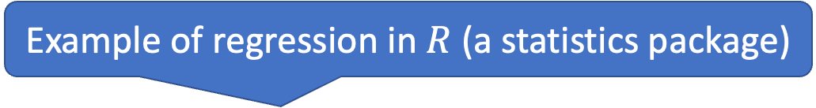
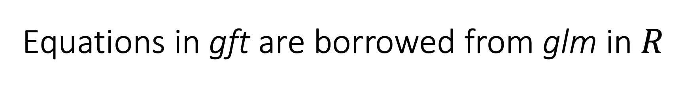
Equations in gft are borrowed from glm in $R$
General Fine-Tuning
General Linear Models
Example of regression in $R$ (a statistics package)
Promised no (python) coding
Variables ($x1$, $x2$, $y$) refer to columns in data.csv
Variables ($label$, $question1$, $question2$) refer to columns in data

Slide 34
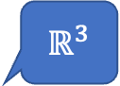
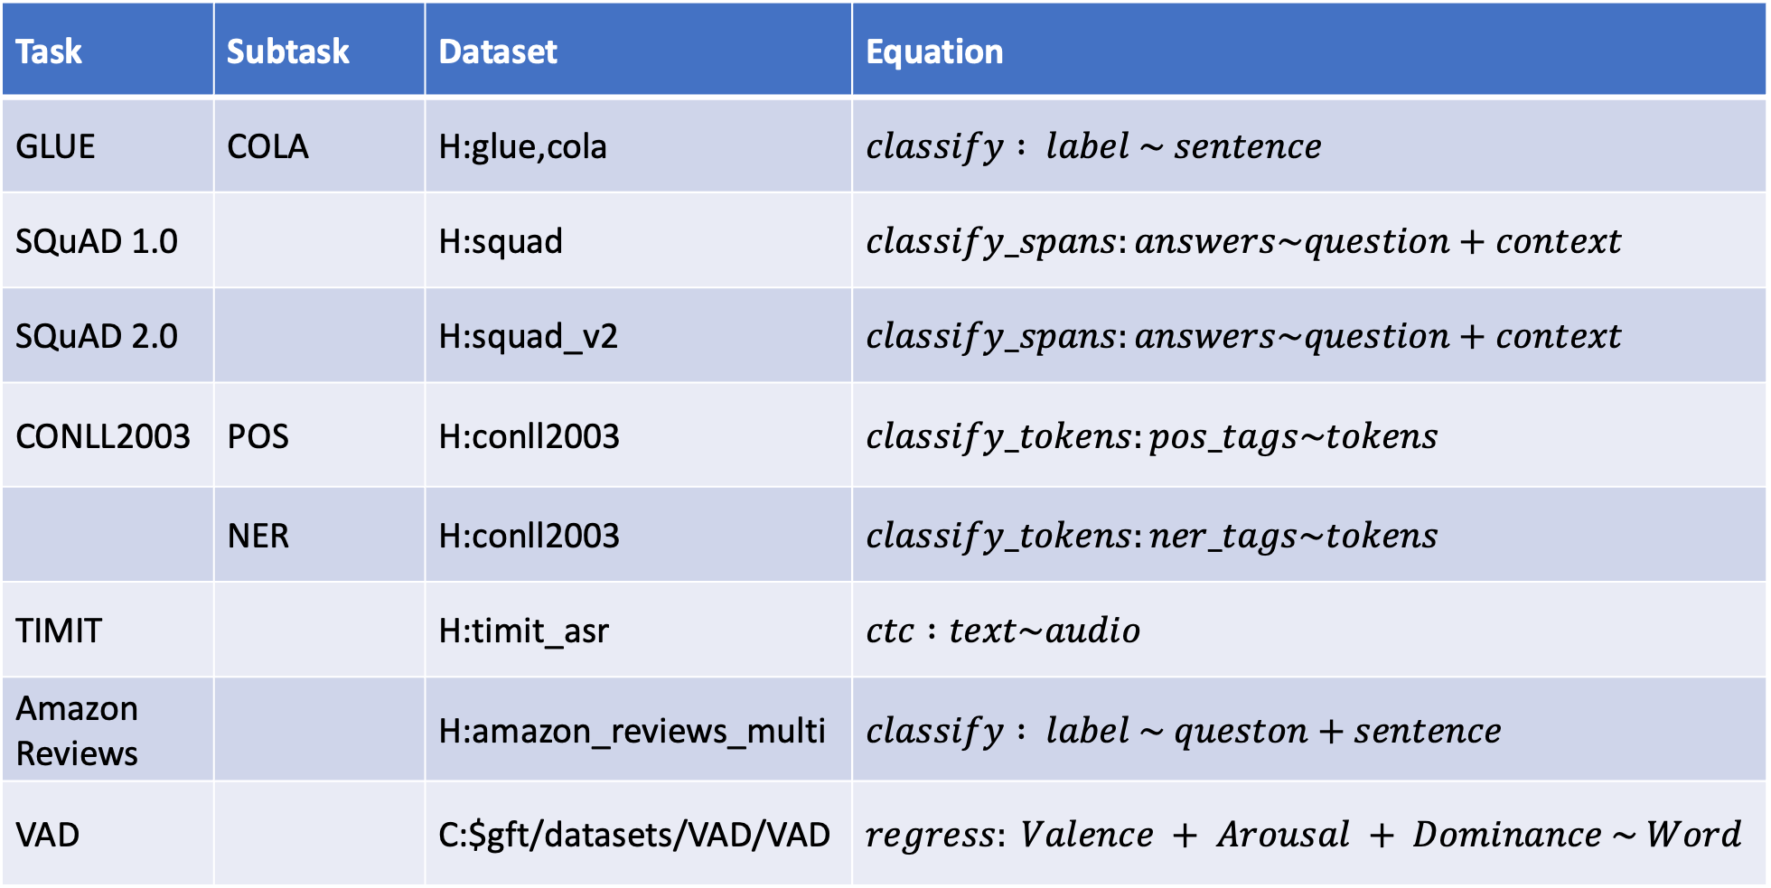
Simple Equations Cover Many Cases of Interest
Task | Subtask | Dataset | Equation
GLUE | COLA | H:glue,cola | $$classify : label \sim sentence$$
SQuAD 1.0 |  | H:squad | $$classify_spans:answers\sim question+context$$
SQuAD 2.0 |  | H:squad_v2 | $$classify_spans:answers\sim question+context$$
CONLL2003 | POS | H:conll2003 | $$classify_tokens:pos_tags\sim tokens$$
 | NER | H:conll2003 | $$classify_tokens:ner_tags\sim tokens$$
TIMIT |  | H:timit_asr | $$ctc :text\sim audio$$
Amazon Reviews |  | H:amazon_reviews_multi | $$classify : label \sim queston+sentence$$
VAD |  | C:$gft/datasets/VAD/VAD | $$regress: Valence + Arousal + Dominance \sim Word$$
aka: Question-Answering, QA
aka: Automatic-Speech-Recognition, ASR
$ℝ^{3}$
Custom

Slide 35
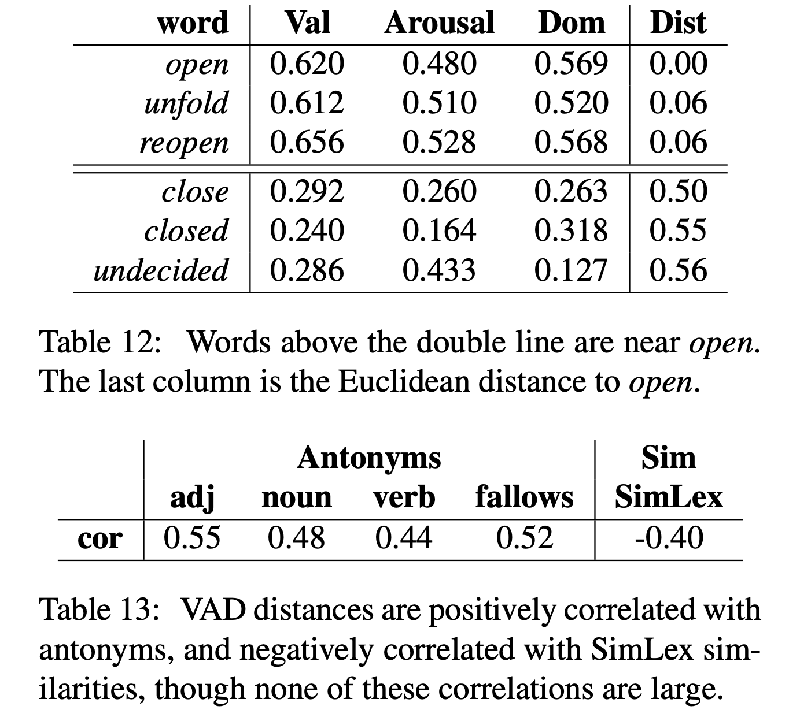
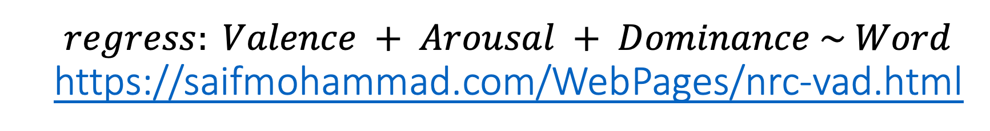
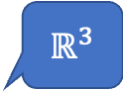
$$regress: Valence + Arousal + Dominance \sim Word$$ https://saifmohammad.com/WebPages/nrc-vad.html
$ℝ^{3}$

Slide 36
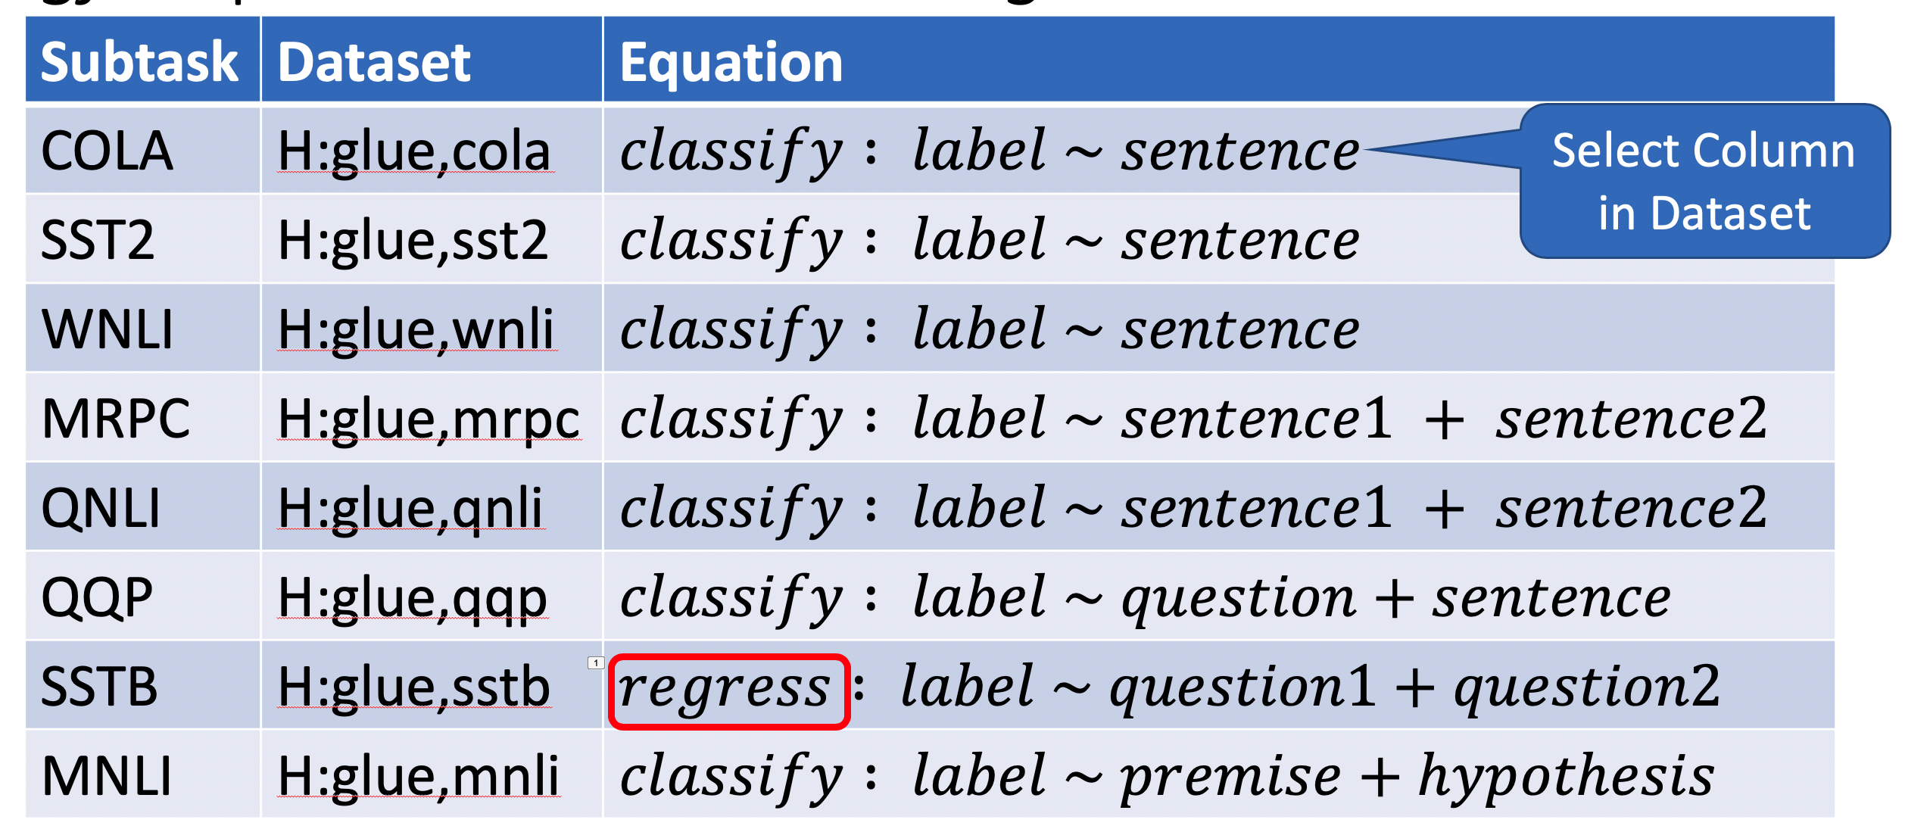
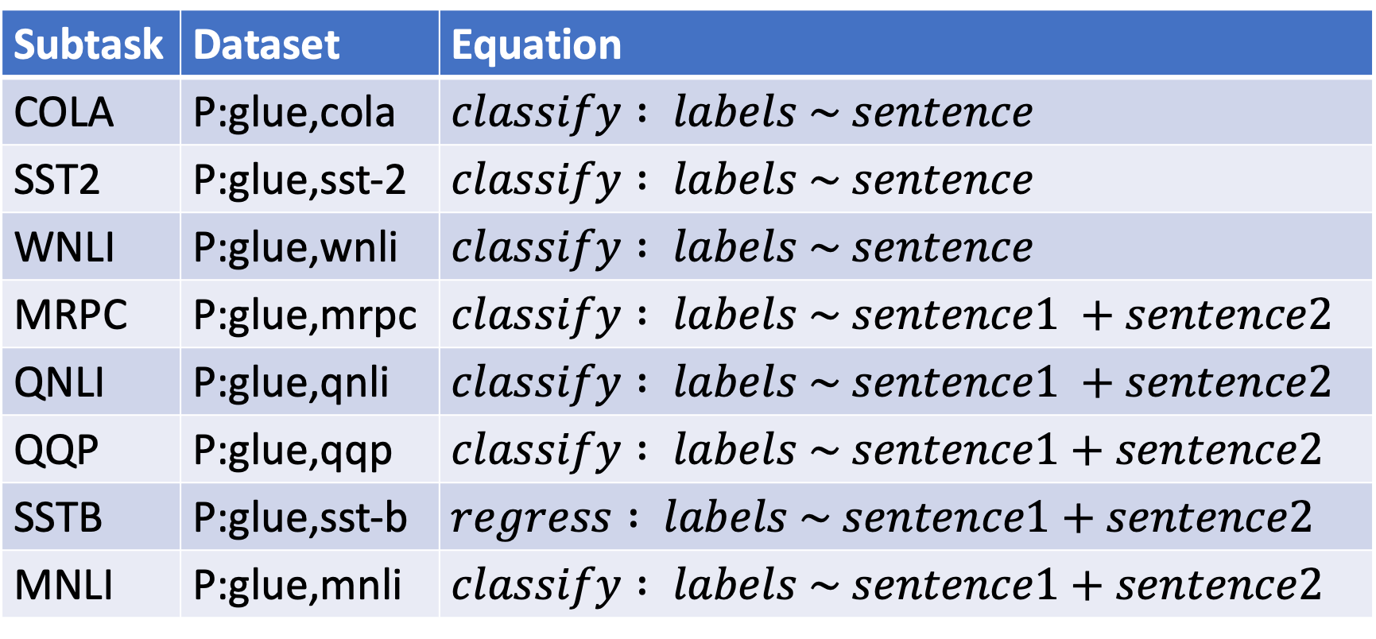
H → P: Porting from HuggingFace to Paddle (Columns have different names)
Subtask | Dataset | Equation
COLA | P:glue,cola | $$classify : labels \sim sentence$$
SST2 | P:glue,sst-2 | $$classify : labels \sim sentence$$
WNLI | P:glue,wnli | $$classify : labels \sim sentence$$
MRPC | P:glue,mrpc | $$classify : labels \sim sentence1 +sentence2$$
QNLI | P:glue,qnli | $$classify : labels \sim sentence1 +sentence2$$
QQP | P:glue,qqp | $$classify : labels \sim sentence1+sentence2$$
SSTB | P:glue,sst-b | $$regress : labels \sim sentence1+sentence2$$
MNLI | P:glue,mnli | $$classify : labels \sim sentence1+sentence2$$
Select Column in Dataset

Slide 37
Two Questions
How do I find the good stuff?
And how do I use the good stuff?

Slide 38
Embarrassment of Riches
Hubs have 30k models & 3k datasets (increasing 3x per year)
Q: How can I find the good stuff?
A: gft_summary

Slide 39
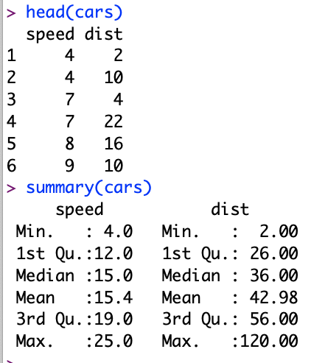
Regression in R: Summarize (almost) anything
Black Points:
cars dataset
Summarize a dataset (cars)
Red Line:
Model (g)

Slide 40
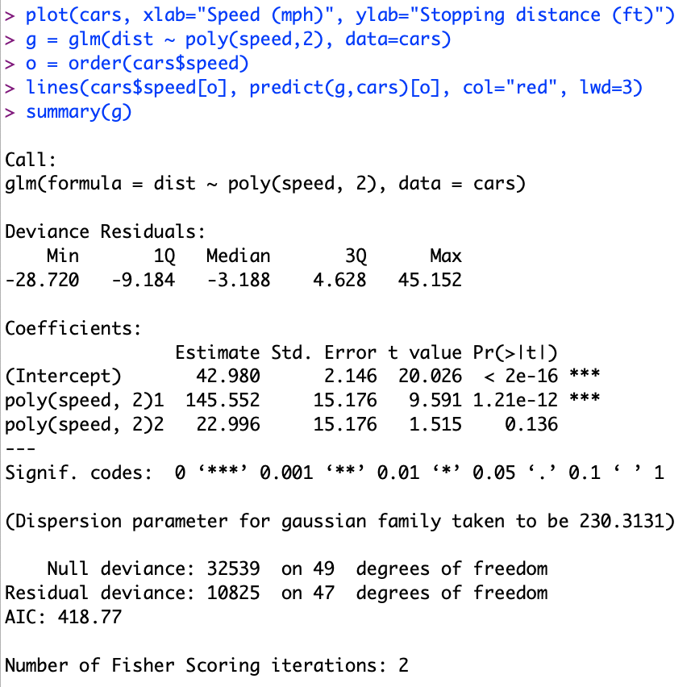
Regression in R: Summarize (almost) anything
Fit a model (g) to data (cars)

Slide 41
Regression in R: Summarize (almost) anything
Fit a model (g) to data (cars)
Summarize a model (g)
Opportunity to Improve g

Slide 42
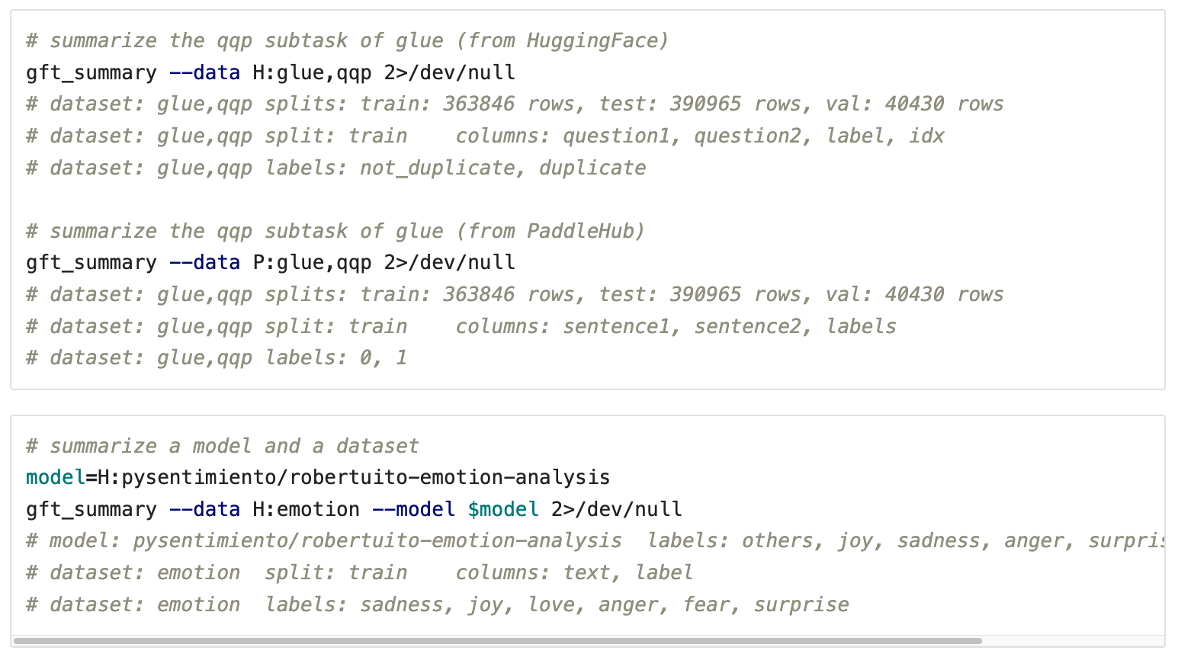
gft_summary: Summarize (almost) anything: datasets, models, tasks, etc.

Slide 43
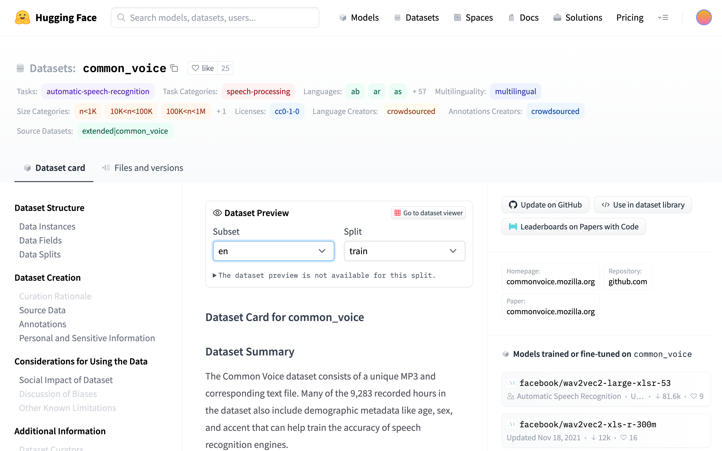
Metrics of Success: How do we find good stuff?
Algo Search: Left Rail
vs
Ad Search: Right Rail
A kind of search engine
Score dataset by:
# of downloads
# of likes
# of models
# of citations

Slide 44
Embarrassment of Riches
Hubs have 30k models & 3k datasets (increasing 3x per year)
Q: How can I find the good stuff?
A: gft_summary
__contains__
Find popular models/datasets that contain substring
__infer__
Find popular models that are associated with task/dataset
Examples:
gft_summary --data H:__contains__emotion --topn 5
gft_summary --model H:__contains__emotion --topn 5
gft_summary --task H:classify --model H:__infer__ --topn 5
gft_summary --data H:emotion --model H:__infer__ --topn 5

Slide 45
How do I find the good stuff? Popular Datasets? gft_summary –data H:__contains__wiki --topn 20
Dataset | Downloads | Likes | PWC
wikitext | 119,031 | 7 | https://paperswithcode.com/dataset/wikitext-2
wikiann | 20,021 | 6 | https://paperswithcode.com/dataset/wikiann-1
wiki_snippets | 16,550 | 0
wikipedia | 14,729 | 8
wiki_bio | 10,135 | 0 | https://paperswithcode.com/dataset/wikibio
wiki_qa | 9,670 | 1 | https://paperswithcode.com/dataset/wikiqa
wiki_hop | 8,961 | 0 | https://paperswithcode.com/dataset/wikihop
wiki_dpr | 5,310 | 0
wiki_split | 5,260 | 0 | https://paperswithcode.com/dataset/wikisplit
wiki40b | 2,618 | 3 | https://paperswithcode.com/dataset/wiki-40b
wikisql | 2,135 | 2 | https://paperswithcode.com/dataset/wikisql
wikihow | 1,601 | 0 | https://paperswithcode.com/dataset/wikihow
wiki_lingua | 1,508 | 1 | https://paperswithcode.com/dataset/wikilingua
kilt_wikipedia | 1,421 | 2
Tevatron/wikipedia-nq-corpus | 1,368 | 0
wiki_auto | 1,258 | 0
wiki_asp | 1,192 | 1 | https://paperswithcode.com/dataset/wikiasp
wikicorpus | 1,098 | 0
wiki_atomic_edits | 1,058 | 3 | https://paperswithcode.com/dataset/wikiatomicedits
iapp_wiki_qa_squad | 1,033 | 0

Slide 46
How do I find the good stuff? Popular Datasets? gft_summary –data H:__contains__ --topn 20
Dataset | Downloads | Likes | PWC
glue | 926,082 | 26 | https://paperswithcode.com/dataset/glue
super_glue | 306,473 | 9 | https://paperswithcode.com/dataset/superglue
wikitext | 119,031 | 7 | https://paperswithcode.com/dataset/wikitext-2
imdb | 105,321 | 8 | https://paperswithcode.com/dataset/imdb-movie-reviews
squad | 99,954 | 22 | https://paperswithcode.com/dataset/squad
squad_es | 72,163 | 0 | https://paperswithcode.com/dataset/squad-es
paws | 65,433 | 1 | https://paperswithcode.com/dataset/paws
librispeech_asr | 65,325 | 12 | https://paperswithcode.com/dataset/librispeech-1
wmt16 | 48,479 | 2 | https://paperswithcode.com/dataset/wmt-2016
xnli | 41,987 | 5 | https://paperswithcode.com/dataset/xnli
snli | 34,045 | 5 | https://paperswithcode.com/dataset/snli
ag_news | 30,456 | 11 | https://paperswithcode.com/dataset/ag-news
anli | 30,245 | 3 | https://paperswithcode.com/dataset/anli
amazon_polarity | 28,584 | 6
squad_v2 | 28,000 | 3 | https://paperswithcode.com/dataset/squad
conll2003 | 26,012 | 11 | https://paperswithcode.com/dataset/conll-2003
red_caps | 25,940 | 2 | https://paperswithcode.com/dataset/redcaps
common_voice | 25,033 | 26 | https://paperswithcode.com/dataset/common-voice
stsb_multi_mt | 23,866 | 4
trec | 23,313 | 3 | https://paperswithcode.com/dataset/trecqa

Slide 47
How do I find the good stuff? Popular Models? gft_summary –model H:__contains__snli --topn 20
Model | Downloads | Likes | Task
ynie/roberta-large-snli_mnli_fever_anli_R1_R2_R3-nli | 31,354 | 2 | text-classification
textattack/bert-base-uncased-snli | 6,651 | 0 | text-classification
boychaboy/SNLI_roberta-base | 3,158 | 0 | text-classification
symanto/sn-xlm-roberta-base-snli-mnli-anli-xnli | 2,575 | 1 | sentence-similarity
ynie/albert-xxlarge-v2-snli_mnli_fever_anli_R1_R2_R3-nli | 2,093 | 1 | text-classification
pritamdeka/S-Biomed-Roberta-snli-multinli-stsb | 671 | 0 | sentence-similarity
jegorkitskerkin/bert-base-dutch-cased-snli | 528 | 1 | sentence-similarity
ynie/bart-large-snli_mnli_fever_anli_R1_R2_R3-nli | 274 | 0 | text-classification
symanto/xlm-roberta-base-snli-mnli-anli-xnli | 151 | 1 | text-classification
persiannlp/mt5-base-parsinlu-snli-entailment | 115 | 0 | text2text-generation
usc-isi/sbert-roberta-large-anli-mnli-snli | 97 | 0 | sentence-similarity
ynie/xlnet-large-cased-snli_mnli_fever_anli_R1_R2_R3-nli | 94 | 0 | text-classification
textattack/albert-base-v2-snli | 67 | 0 | text-classification
pmthangk09/bert-base-uncased-esnli | 53 | 0 | text-classification
boychaboy/SNLI_bert-base-uncased | 46 | 0 | text-classification
ynie/electra-large-discriminator-snli_mnli_fever_anli_R1_R2_R3-nli | 44 | 0 | text-classification
NDugar/debertav3-mnli-snli-anli | 42 | 2 | zero-shot-classification
boychaboy/SNLI_bert-large-cased | 39 | 0 | text-classification
persiannlp/mt5-small-parsinlu-snli-entailment | 37 | 0 | text2text-generation
boychaboy/SNLI_roberta-large | 33 | 0 | text-classification

Slide 48
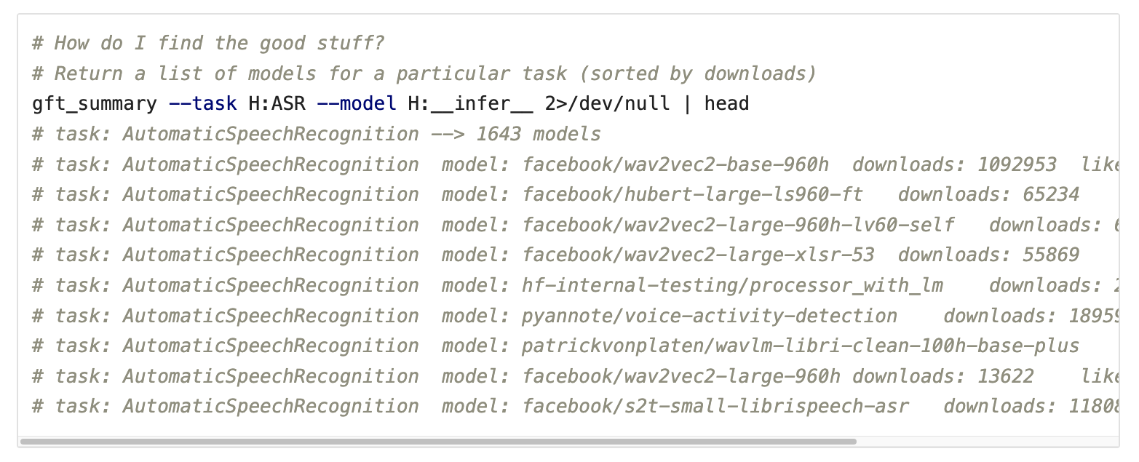
gft_summary: How do I find the good stuff? Find models associated with a task (ASR)
task → list of models (by downloads)

Slide 49

gft_summary: How do I find the good stuff? Find models associated with a task (ASR)
task → list of models (by downloads)
dataset → list of models (by downloads)

Slide 50

gft_summary: How do I find the good stuff? Find popular models associated with a dataset

Slide 51

gft_summary: How do I find the good stuff? Find popular models associated with a task (MT)

Slide 52
Embarrassment of Riches
Hubs have 30k models & 3k datasets (increasing 3x per year)
Q: How can I find the good stuff?
A: gft_summary
__contains__
Find popular models/datasets that contain substring
__infer__
Find popular models that are associated with task/dataset
Examples:
gft_summary --data H:__contains__emotion --topn 5
gft_summary --model H:__contains__emotion --topn 5
gft_summary --task H:classify --model H:__infer__ --topn 5
gft_summary --data H:emotion --model H:__infer__ --topn 5

Slide 53

What counts as ``good’’ stuff?
Academic Metrics:
Peer Review (Citations)
Social Media Metrics:
Popular (Downloads)
Tweets / Blogs
SOTA: State of the art
Papers with Code
Leaderboards
Search Engine Optimization (SEO)
Adversarial Game (Arbitrage):
Better Web Search → ``Better’’ SEOs → Better Web Search

Slide 54

How do I find the good stuff? Popular Models? gft_summary –model H:__contains__snli --topn 20
Model | Downloads | Likes | Task
ynie/roberta-large-snli_mnli_fever_anli_R1_R2_R3-nli | 31,354 | 2 | text-classification
textattack/bert-base-uncased-snli | 6,651 | 0 | text-classification
boychaboy/SNLI_roberta-base | 3,158 | 0 | text-classification
symanto/sn-xlm-roberta-base-snli-mnli-anli-xnli | 2,575 | 1 | sentence-similarity
ynie/albert-xxlarge-v2-snli_mnli_fever_anli_R1_R2_R3-nli | 2,093 | 1 | text-classification
pritamdeka/S-Biomed-Roberta-snli-multinli-stsb | 671 | 0 | sentence-similarity
jegorkitskerkin/bert-base-dutch-cased-snli | 528 | 1 | sentence-similarity
ynie/bart-large-snli_mnli_fever_anli_R1_R2_R3-nli | 274 | 0 | text-classification
symanto/xlm-roberta-base-snli-mnli-anli-xnli | 151 | 1 | text-classification
persiannlp/mt5-base-parsinlu-snli-entailment | 115 | 0 | text2text-generation
usc-isi/sbert-roberta-large-anli-mnli-snli | 97 | 0 | sentence-similarity
ynie/xlnet-large-cased-snli_mnli_fever_anli_R1_R2_R3-nli | 94 | 0 | text-classification
textattack/albert-base-v2-snli | 67 | 0 | text-classification
pmthangk09/bert-base-uncased-esnli | 53 | 0 | text-classification
boychaboy/SNLI_bert-base-uncased | 46 | 0 | text-classification
ynie/electra-large-discriminator-snli_mnli_fever_anli_R1_R2_R3-nli | 44 | 0 | text-classification
NDugar/debertav3-mnli-snli-anli | 42 | 2 | zero-shot-classification
boychaboy/SNLI_bert-large-cased | 39 | 0 | text-classification
persiannlp/mt5-small-parsinlu-snli-entailment | 37 | 0 | text2text-generation
boychaboy/SNLI_roberta-large | 33 | 0 | text-classification
Downloads $≠$ SOTA
Defaults & Ease-of-Use

Slide 55


SOTA-Chasing: Leaderboards Considered Harmful SOTA-chasing refers to papers that report SOTA numbers, but contribute little of lasting value to the literature. The point is the pointlessness.

Slide 56

PWC: https://paperswithcode.com/dataset/glue

Slide 57


PWC $≠$GLUE Leaderboard

Slide 58
How do I find ``good’’ tasks?
``Good’’ tasks are like ``good’’ stuff
Academic Metrics:
Peer Review (Citations)
Social Media Metrics:
Popular (Downloads)
Tweets / Blogs
SOTA: State of the art
Papers with Code
Leaderboards
Search Engine Optimization (SEO)
Adversarial Game (Arbitrage):
Better Web Search → ``Better’’ SEOs → Better Web Search

Slide 59


--task argument → HuggingFace Pipelines https://huggingface.co/docs/transformers/v4.16.2/en/main_classes/pipelines

Slide 60


Equation Keywords $≈$ Pipeline Tasks
Task | Subtask | Dataset | Equation
GLUE | COLA | H:glue,cola | $$classify : label \sim sentence$$
SQuAD 1.0 |  | H:squad | $$classify_spans:answers\sim question+context$$
SQuAD 2.0 |  | H:squad_v2 | $$classify_spans:answers\sim question+context$$
CONLL2003 | POS | H:conll2003 | $$classify_tokens:pos_tags\sim tokens$$
 | NER | H:conll2003 | $$classify_tokens:ner_tags\sim tokens$$
TIMIT |  | H:timit_asr | $$ctc :text\sim audio$$
Amazon Reviews |  | H:amazon_reviews_multi | $$classify : label \sim queston+sentence$$
VAD |  | C:$gft/datasets/VAD/VAD | $$regress: Valence + Arousal + Dominance \sim Word$$

Slide 61
What are the most popular tasks? 30k Models → Pipeline Tasks (computed from $gft/gft_internals/huggingface_hub/huggingface_datasets.txt)
Models | Pipeline Task
9537 | None
3949 | text-generation
3143 | text-classification (classify)
2390 | fill-mask
2253 | text2text-generation
1508 | automatic-speech-recognition (ctc)
1460 | translation
1340 | token-classification (classify_tokens)
1042 | conversational
983 | question-answering (classify_spans)
982 | feature-extraction
338 | sentence-similarity
320 | summarization
261 | image-classification
Models | Pipeline Task
160 | text-to-speech
68 | zero-shot-classification
55 | audio-to-audio
54 | audio-classification
26 | table-question-answering
12 | object-detection
11 | image-segmentation
9 | text-to-image
4 | structured-data-classification
4 | image-to-text
2 | voice-activity-detection
1 | zero-shot-image-classification
1 | speech-segmentation
1 | protein-folding
1 | pipeline_tag

Slide 62
Popular Text Classification Models gft_summary --task H:text-classification Input: Task → Output: Popular Models
Model | Downloads | Likes
cross-encoder/ms-marco-MiniLM-L-12-v2 | 11,542,439 | 4
distilbert-base-uncased-finetuned-sst-2-english | 4,188,846 | 38
facebook/bart-large-mnli | 1,253,261 | 89
cross-encoder/nli-distilroberta-base | 581,821 | 6
cardiffnlp/twitter-roberta-base-sentiment | 542,530 | 40
nlptown/bert-base-multilingual-uncased-sentiment | 541,492 | 30
roberta-large-mnli | 520,103 | 12
finiteautomata/beto-sentiment-analysis | 496,725 | 6
j-hartmann/emotion-english-distilroberta-base | 273,134 | 16
cardiffnlp/twitter-roberta-base-emotion | 259,369 | 5

Slide 63
Summarize Tasks $gft/examples/summary_examples/task
gft_summary --task H:audio-classification
gft_summary --task H:audio-to-audio
gft_summary --task H:automatic-speech-recognition
gft_summary --task H:conversational
gft_summary --task H:feature-extraction
gft_summary --task H:fill-mask
gft_summary --task H:image-classification
gft_summary --task H:image-segmentation
gft_summary --task H:image-to-text
gft_summary --task H:object-detection
gft_summary --task H:protein-folding
gft_summary --task H:question-answering
gft_summary --task H:sentence-similarity
gft_summary --task H:speech-segmentation
gft_summary --task H:structured-data-classification
gft_summary --task H:summarization
gft_summary --task H:table-question-answering
gft_summary --task H:text2text-generation
gft_summary --task H:text-classification
gft_summary --task H:text-generation
gft_summary --task H:text-to-image
gft_summary --task H:text-to-speech
gft_summary --task H:token-classification
gft_summary --task H:translation
gft_summary --task H:voice-activity-detection
gft_summary --task H:zero-shot-classification
gft_summary --task H:zero-shot-image-classification

Slide 64

30k Models → Pipeline Tasks (computed from $gft/gft_internals/huggingface_hub/huggingface_datasets.txt)
Models | Pipeline Task
9537 | None
3949 | text-generation
3143 | text-classification (classify)
2390 | fill-mask
2253 | text2text-generation
1508 | automatic-speech-recognition (ctc)
1460 | translation
1340 | token-classification (classify_tokens)
1042 | conversational
983 | question-answering (classify_spans)
982 | feature-extraction
338 | sentence-similarity
320 | summarization
261 | image-classification
Models | Pipeline Task
160 | text-to-speech
68 | zero-shot-classification
55 | audio-to-audio
54 | audio-classification
26 | table-question-answering
12 | object-detection
11 | image-segmentation
9 | text-to-image
4 | structured-data-classification
4 | image-to-text
2 | voice-activity-detection
1 | zero-shot-image-classification
1 | speech-segmentation
1 | protein-folding
1 | pipeline_tag

Slide 65
Two Questions
How do I find the good stuff?
And how do I use the good stuff?
A: gft_predict

Slide 66



Question: How do I use the good stuff? Answer: gft_predict
$$f\left(x\right)→\hat{y}$$
No model specified
$$x$$
$$\hat{y}$$
Score

Slide 67

Inference: gft_predict
gft_predict
Input from a dataset or stdin
Output to stdout
Arguments (many are optional)
--data, --split, --model, --eqn, --task
--eqn $task: lhs \sim rhs$
Variables in $lhs$ and $rhs$
refer to columns in dataset
Since the terminology for tasks is currently in a state of flux,
gft supports a number of aliases
(shown in parentheses)
Tasks (aliases in parenthesis)
classify (text-classification)
classify_tokens
(token-classification)
classify_spans
(QA, question-answering)
classify_audio (audio-classification)
classify_images (image-classification)
regress
text-generation
MT (translation)
ASR
(ctc, automatic-speech-recognition)
fill-mask

Slide 68
Specifying –model argument
Default Model → Sentiment Classes
A Model with Emotion Classes

Slide 69
More tasks (1 of 4)
Text Classification
Token Classification
Fill Mask
Text Generation
Machine Translation

Slide 70
More tasks (2 of 4)
Text Classification
Token Classification
Fill Mask
Text Generation
Machine Translation

Slide 71
More tasks (3 of 4)
Text Classification
Token Classification
Fill Mask
Text Generation
Machine Translation
Output is non-deterministic

Slide 72
More tasks (4 of 4)
Text Classification
Token Classification
Fill Mask
Text Generation
Machine Translation

Slide 73
More tasks (4 of 4)
Text Classification
Token Classification
Fill Mask
Text Generation
Machine Translation
English → French
English → Chinese
A Model for: English → French
A Model for: English → Chinese

Slide 74


gft_predict –task image-classification
Default Model → 1000 Labels
A Model with Cat/Dog Labels

Slide 75



History behind Cat/Dog Task

Slide 76


Inputs can also come from files (as well as URLs) There are a few images (and audio files) under $gft/doc/objects

Slide 77




Task: Speech Recognition (ASR, ctc)
Input from stdin
Input from dataset

Slide 78
Wrapping up Part A
Two Questions
How do I find the good stuff?
And how do I use the good stuff?
A: gft_predict
Cheat Sheet
Guide to Hundreds of Examples
Motivations for GFT
Why change terminology?
Part B

Slide 79


gft Cheat Sheet
4 Functions
4 Arguments
gft_fit: $f_{pre}$ →$f_{post}$(fine-tuning)
4 Arguments, --output_dir, --metric, --splits
(plus most args in most hubs)
gft_predict: $f\left(x\right)→\hat{y}$ (inference)
Input: 4 Arguments ($x$ from data or stdin)
Output: $\hat{y}$ for each $x$
gft_eval: Score model on dataset
Input: 4 Arguments, --split, --metric, …
Output: Score
gft_summary: Find good stuff
4 Arguments
(may include: __contains__, __infer__)
--data
--model
--eqn $task:y\sim x_{1}+x_{2}$
--task
classify (text-classification)
classify_tokens (token-classification)
classify_spans (QA, question-answering)
classify_audio (audio-classification)
classify_images (image-classification)
regress
text-generation
MT (translation)
ASR (ctc, automatic-speech-recognition)
fill-mask

Slide 80

Guide to Hundreds of Examples
Subdirectories under $gft/examples
Naming Conventions
fit_examples (1 arg)
--output_dir $1
predict_examples (0 args)
eval_examples (0 args)
summary_examples (0 args)
Look for *.sh files under these directories
find $gft/examples –name ”*.sh”
4 arguments:
--data, --model, --eqn, --task
Models
model.HuggingFace/model.Paddle
our_models/their_models
Data
data.HuggingFace/data.Paddle

Slide 81
Cola subset of Glue, with pretrained models and data from HuggingFace $gft/examples/eval_examples/model.HuggingFace/language/data.HuggingFace/their_models/glue/cola.sh
Input
Output (Sorted by score; 4 errors removed)
for model in textattack/distilbert-base-uncased-CoLA textattack/bert-base-uncased-CoLA textattack/distilbert-base-cased-CoLA textattack/roberta-base-CoLA cointegrated/roberta-large-cola-krishna2020 textattack/albert-base-v2-CoLA gchhablani/bert-base-cased-finetuned-cola yoshitomo-matsubara/bert-base-uncased-cola howey/roberta-large-cola textattack/xlnet-base-cased-CoLA isakbos/Q8BERT_COLA_L_512 EhsanAghazadeh/bert-large-uncased-CoLA_A EhsanAghazadeh/bert-large-uncased-CoLA_B 09panesara/distilbert-base-uncased-finetuned-cola yoshitomo-matsubara/bert-large-uncased-cola textattack/xlnet-large-cased-CoLA Alireza1044/albert-base-v2-cola pmthangk09/bert-base-uncased-glue-cola kamivao/autonlp-cola_gram-208681 mrm8488/deberta-v3-small-finetuned-cola 123abhiALFLKFO/distilbert-base-uncased-finetuned-cola Ahren09/distilbert-base-uncased-finetuned-cola
do
gft_eval --data H:glue,cola --split val \
--eqn 'classify: label ~ sentence’ --model H:$model \
--metric H:glue,cola --figure_of_merit matthews_correlation
done
Model | Score | Seconds
howey/roberta-large-cola | 0.65 | 3.93
textattack/roberta-base-CoLA | 0.64 | 1.6
yoshitomo-matsubara/bert-large-uncased-cola | 0.63 | 5.12
mrm8488/deberta-v3-small-finetuned-cola | 0.63 | 1.62
EhsanAghazadeh/bert-large-uncased-CoLA_A | 0.61 | 4.05
yoshitomo-matsubara/bert-base-uncased-cola | 0.61 | 1.58
EhsanAghazadeh/bert-large-uncased-CoLA_B | 0.60 | 4.13
gchhablani/bert-base-cased-finetuned-cola | 0.60 | 1.57
pmthangk09/bert-base-uncased-glue-cola | 0.58 | 1.53
textattack/albert-base-v2-CoLA | 0.58 | 1.59
textattack/distilbert-base-uncased-CoLA | 0.57 | 1.04
kamivao/autonlp-cola_gram-208681 | 0.56 | 1.52
Alireza1044/albert-base-v2-cola | 0.55 | 1.71
09panesara/distilbert-base-uncased-finetuned-cola | 0.54 | 0.87
textattack/bert-base-uncased-CoLA | 0.53 | 2.35
123abhiALFLKFO/distilbert-base-uncased-finetuned-cola | 0.53 | 0.9
textattack/xlnet-base-cased-CoLA | 0.50 | 2.23
textattack/distilbert-base-cased-CoLA | 0.46 | 0.88
isakbos/Q8BERT_COLA_L_512 | 0.00 | 1.77
textattack/xlnet-large-cased-CoLA | 0.00 | 5.08
cointegrated/roberta-large-cola-krishna2020 | -0.65 | 4.31
Popular models containing “cola”
(not SOTA)

Slide 82
Wrapping up Part A
Two Questions
How do I find the good stuff?
And how do I use the good stuff?
A: gft_predict
Cheat Sheet
Guide to Hundreds of Examples
Motivations for GFT
Why change terminology?
Part B

Slide 83



Hubs: Data, Models, Examples (with $\begin{matrix}too much \\ ⋀\end{matrix}$ code) Embarrassment of Riches: Overwhelming
Goal for gft: Accessibility
HuggingFace
https://huggingface.co/
PaddleNLP and PaddleHub
https://github.com/PaddlePaddle

Slide 84

Advantages of Higher-Level Little Languages
Ease of use
Accessible to broader audience
Deep Nets for Poets (see next slide)
Hide complexity
1-line of gft $≪$ 800+ lines of python
More transparency; fewer bugs
Avoid special cases
Standard examples on hubs
expect users to modify python
different programs for different datasets/models/tasks
gft encourages code re-use
gft uses similar code/algorithms as examples
with similar performance and computational costs
but generalizes over more datasets/models/tasks
Portability across suppliers
Mix and Match Across Hubs
(HuggingFace, PaddleNLP)

Slide 85
Hub Strategy: Usage >> SOTA
(Sensible) Priority for Startups
(Mistaken) Priority Research
Startup Strategy:
Get big quick
SOTA is like sprinting (hard work)
Avoid temptation to sprint to front
(except when it is worth the effort)
Hubs spend most of the race
in the peloton drafting researchers
Make it easy for 3rd parties
to post their best models on your hub
Use of 3rd parties → Wide range in quality
Best are amazing: best in class, industrial strength…
But some don’t work well, and may not even load…
Help users find good stuff

Slide 86

Unix for Poets → Deep Nets for Poets
This tutorial → Community-building
Slides for a Linguistic Summer School
Unix for Poets: Slides from 1990s
When empiricism was just taking off
Too much low hanging fruit to pick ourselves
Revival of 1950s Empiricism in 1990s
Community-building exercises
Unix for Poets
EMNLP (Empirical Methods in NLP)
Linguistic Data Consortium (LDC)
Deep nets in 2020s
Community-building exercises
Deep Nets for Poets
(target audience includes non-programmers)
Deep Nets will benefit
if we can increase demand for what we do

Slide 87
Wrapping up Part A
Two Questions
How do I find the good stuff?
And how do I use the good stuff?
A: gft_predict
Cheat Sheet
Guide to Hundreds of Examples
Motivations for GFT
Why change terminology?
Part B

Slide 88


Why Change Terminology?
More opportunity for academics
& Computational Linguistics
Standard Terminology | Proposed Alternatives
Base/Foundation/Pre-Trained | $$f_{pre}$$
Fine-Tuning | fit
Inference | predict
Not this
Emphasize this
Emphasize this
https://www.youtube.com/watch?v=dG628PEN1fY
Industry has an unfair advantage over academia
Pre-training requires $$$$, Big Data & Logistics:
Big Investments → Risk Adverse → Less Creativity

Slide 89


VLSI History http://www.eecs.mit.edu/docs/newsletter/VLSI.pdf http://ai.eecs.umich.edu/people/conway/Memoirs/MIT/MIT_Reminiscences.pdf
Perspective from MIT and beyond:
IBM, Silicon Valley, Mich, LGBTQ, etc.
Think of $f_{pre}$ like Intel CPU chips
Universities can afford
to program CPUs and models (fit/predict)
but not VLSI fabrication ($f_{pre}$)
Jon Allen (my thesis advisor at MIT)
Invested big $$$$ in VLSI fabrication
Big $$$$ → (Too) Much Responsibility
Creativity requires willingness to take risks
Industry can afford to work on projects
with industrial challenges/rewards:
Capital, ROI, Scale, Logistics
Academics have other priorities:
Bottom line: $fit/predict ≫f_{pre}$

Slide 90


Model Compression
Popular Choices on Hubs
Model Compression:
Trade-offs: Space, Time, Accuracy
Pick any two
Commercial Practice
Commercial Practice
https://arxiv.org/pdf/2002.11985.pdf

Slide 91





Focus on Bottlenecks
Bottleneck for Global Warming:
$$cost\left(transportation\right)≫5 cars$$
$$cost\left(smart speakers\right)≫5 cars$$
Commercial Practice: $cost(inference) ≫ cost(training)$
Commercial Practice: $cost(inference) ≫ cost(training)$
Fixed Costs: One-time up-front
Training Costs $≈$5 cars
Variable Costs: Recurring costs
Inference Costs $≫$5 cars
Deploy a model to 1B people
Who use it every day (for years)
If the application goes viral (success)
$variable costs≫fixed costs$
$cost(inference) ≫ cost(training)$
Relatively small

Slide 92
Wrapping up Part A: Glass is Half Full Amazing how much can be done with so little (gft)
Two Questions
How do I find the good stuff?
And how do I use the good stuff?
A: gft_predict
Cheat Sheet
Guide to Hundreds of Examples
Motivations for GFT
Why change terminology?
Part B: Glass is Half Empty
No one would suggest that fit/predict are AI

